Slide 1
Highway 401 Bridge Improvements at Collins Creek and Interchange/Bridge Improvements at Kingston Road 38 and Sydenham Road
City of Kingston, ON
Class Environmental Assessment and Preliminary Design Study (GWP 4029-20-00)
Public Information Centre (PIC) #1 (Virtual)
May 8th, 2024
Hwy401KingstonBridgesEA.ca
If you require any assistance regarding the accessibility of these materials, please let us know by emailing ProjectTeam@hwy401kingstonbridgesea.ca and we would be happy to assist you.
Pour obtenir des renseignements en français, composer le 1-705-919-6786 (Patrick Hébert), Courriel: patrick.hebert1@aecom.com

Slide 2
Welcome
  Thank you for your participation. Your input is appreciated!
  Other information available on this website includes the following:
      PIC #1 Video Presentation
      PIC #1 Presentation Slides [PDF]
      PIC #1 Presentation Transcript [PDF]
      Sydenham Road Bridge Replacement / Alignment Alternatives [PDF]
      Sydenham Road Interchange Alternatives [PDF]
      Preliminary Traffic Management Alternatives [PDF]
  We invite you to please review the presentation material and submit any comments using the Comment Sheet provided.
Please provide us with your input!
  Study Website:
  Hwy401KingstonBridgesEA.ca
2

Slide 3
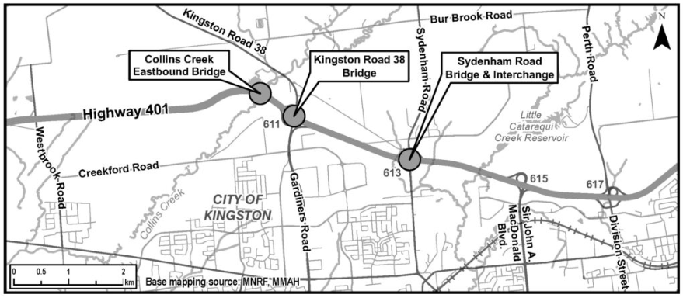
Project Overview
The Ontario Ministry of Transportation (MTO) has retained the services of AECOM to undertake a Preliminary Design (PD) and Class Environmental Assessment (Class EA) Study for the replacement of two bridges that are approaching the end of their service life on Highway 401 including Eastbound (EB) Collins Creek Bridge and Sydenham Road Bridge within the City of Kingston (GWP 4029-20-00).
This study includes:
  Determining the structural needs of the aging bridges including accommodating the future footprint of Highway 401, preliminary construction staging, and traffic management needs.
  Determining the interchange improvement needs at Sydenham Road and Highway 401 for future operations.
  Developing a preliminary traffic management plan for Kingston Road 38 bridge replacement and a new eastbound on-ramp. The need for a Kingston Road 38 bridge replacement and a new eastbound on-ramp was identified in a previous MTO Class EA (GWP 4049-11-00 Highway 401/Kingston Road 38 Interchange Operational Improvements) completed in 2016.
  Developing a preliminary design that allows for the technically preferred bridge replacement and interchange improvement works to be implemented efficiently, minimizing construction costs, traffic disruption, and future waste.

Slide 4
Purpose of Public Information Centre (PIC) # 1
The purpose of this Public Information Centre (PIC) is to present and receive feedback on the following:
    Study area and scope.
    MTO Class EA Process.
    Key Objectives of the study, study process, and timing of study activities.
    Existing conditions of the study area.
    Challenges and Opportunities and the need for highway improvements.
    Alternatives being considered to address the identified challenges including alternative interchange configurations at Sydenham Road and bridge replacement strategies.
    Preliminary criteria to be used to evaluate the alternatives.
    Next Steps.
4

Slide 5
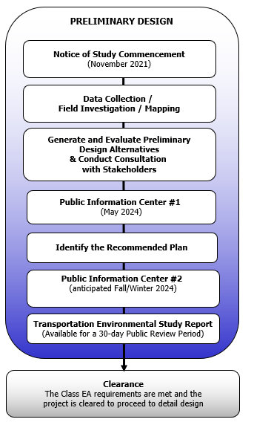
MTO Class EA Process
    EA Process:
    This Preliminary Design and Class Environmental Assessment study is following the approved planning process for a Group ‘B’ in accordance with the MTO Class EA for Provincial Transportation Facilities (2000).
    Environmental Studies & EA Documentation:
    Investigations pertaining to the natural, socio-economic, and cultural heritage environments are being undertaken to summarize existing conditions and to identify any areas of environmental concern or constraint.
    This information will be used to evaluate the alternatives, assess the potential for impact and in the selection of the Recommended Plan and the development of appropriate mitigation measures.
    A Transportation Environmental Study Report (TESR) will be prepared to document the study process including a summary of the consultation completed. The TESR will be placed on the public record for a 30-day review period.
    Consultation is a key component of the MTO Class EA process and is ongoing throughout this study. Consultation is being completed with Indigenous Communities, agencies, the public, key stakeholders, and also includes meetings with a Municipal Advisory Committee (MAC) at key milestones during the process.
We Are Here
5

Slide 6
Key Study Components
    Key study components include:
  Review of the existing conditions and deficiencies within the project limits;
  Investigation of reasonable alternatives to address the current and future transportation needs at the bridge locations;
  Completion of Environmental investigations, documentation, and consultation;
  Preparation of a Group ‘B’ TESR and Preliminary Design Report (PDR);
  Traffic Analysis & Preliminary Construction Staging;
  Other technical specialty studies including Structural, Electrical (illumination and traffic signals), Pavement, Foundations, and Drainage & Hydrology Engineering;
  Identification of utility impacts and preliminary utility relocation requirements.
6

Slide 7
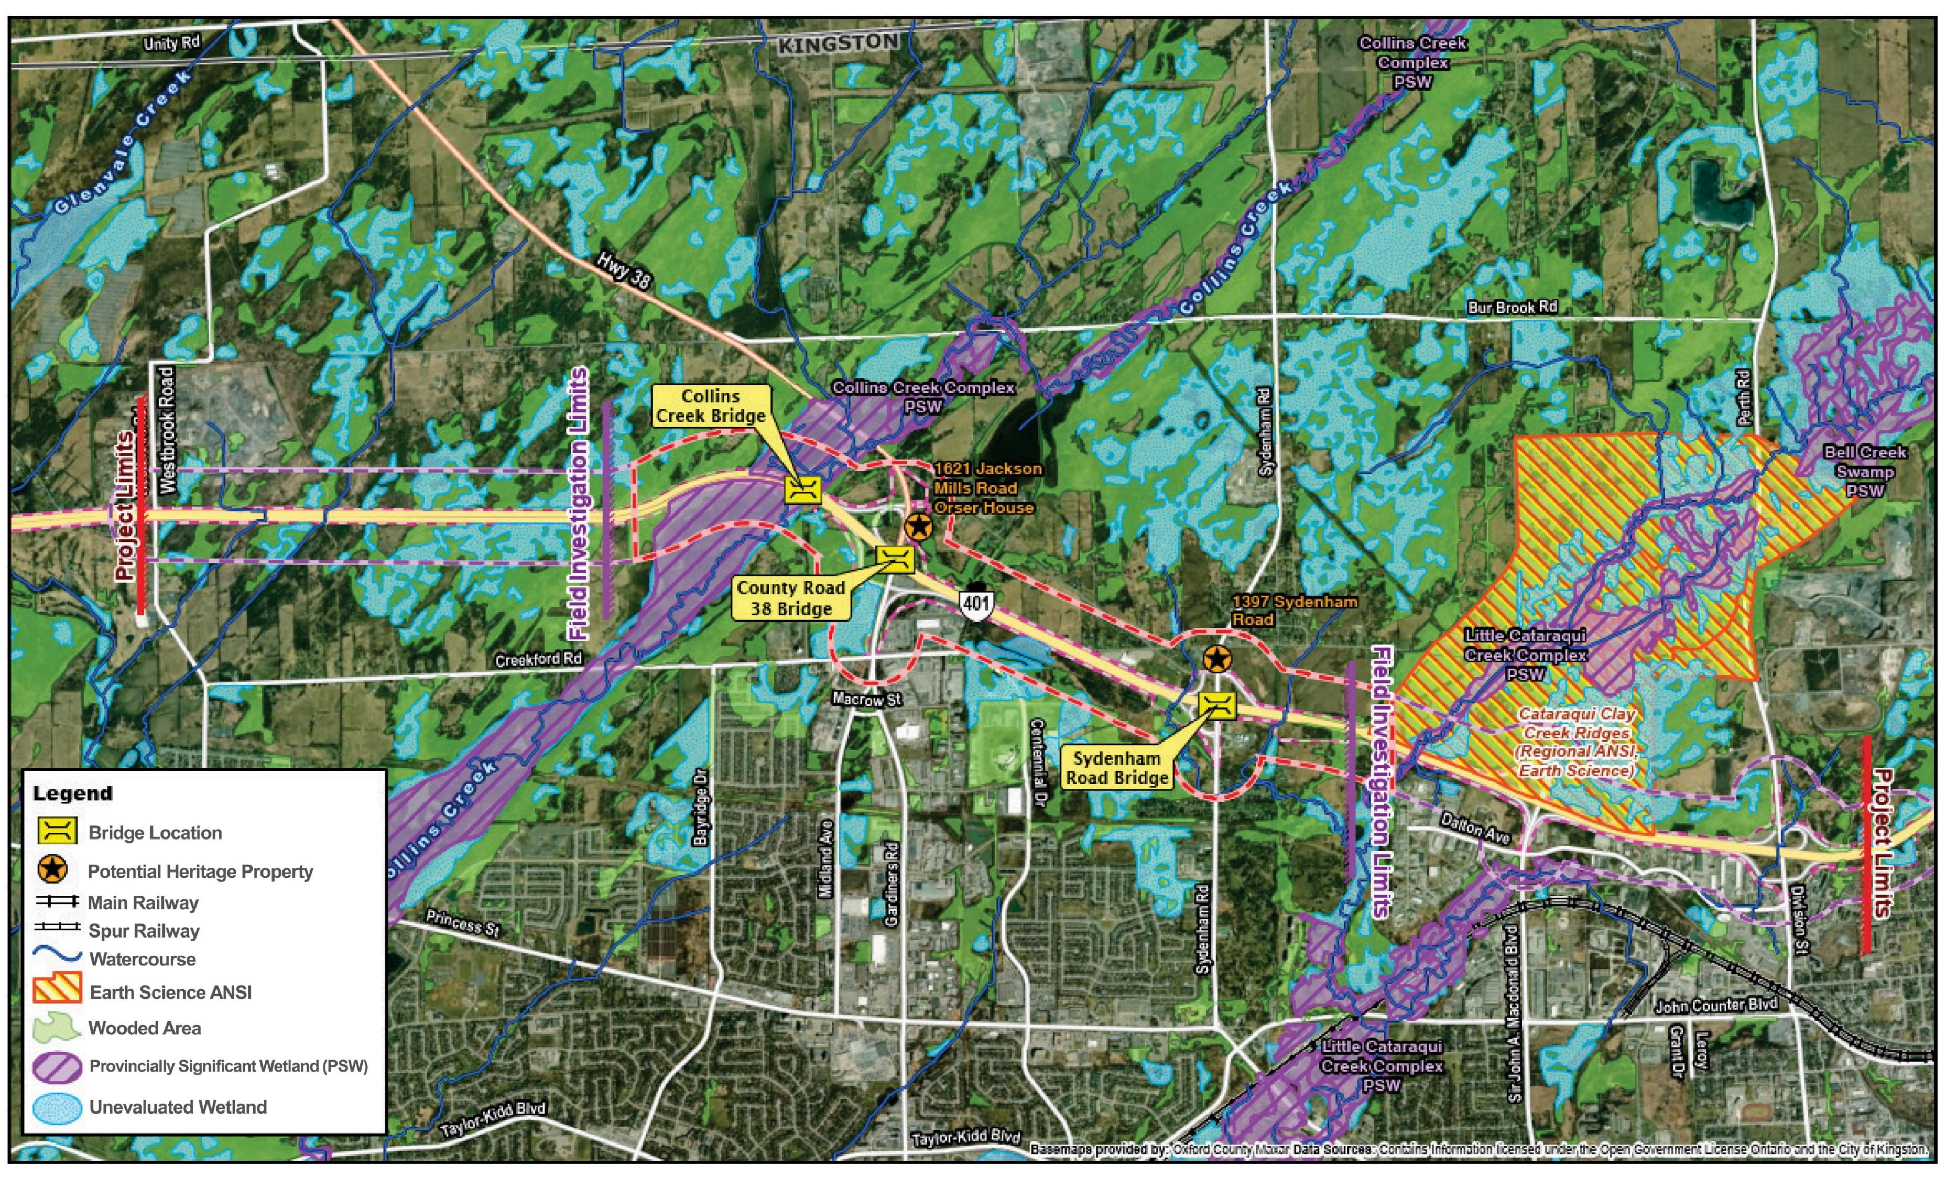
Environmental Existing Conditions
Environmental studies are currently underway to document existing conditions.
There are a number of sensitive environmental features within the study area that will be considered in the evaluation of alternatives and ultimately, in selection of the Recommended Plan.
7

Slide 8
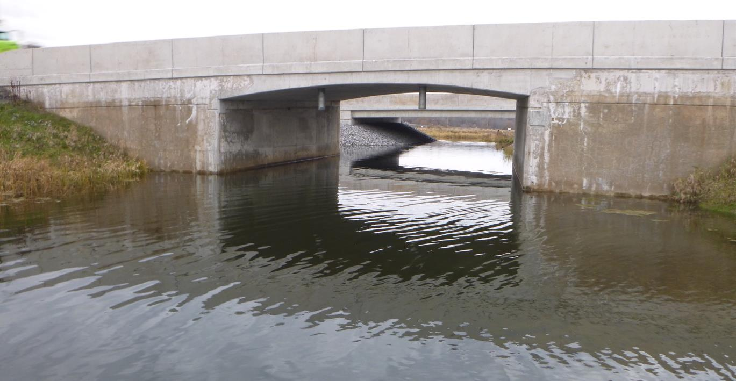
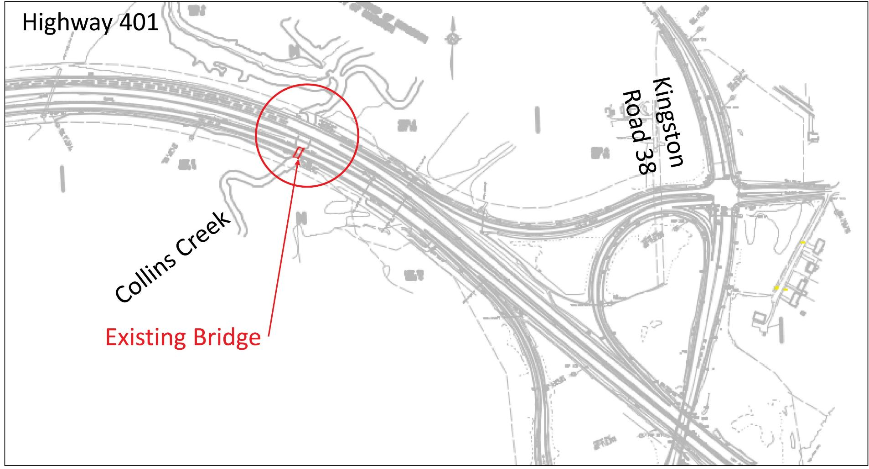
Eastbound (EB) Collins Creek Overpass Overview
Background
Existing bridge built in 1959.
Adjacent Westbound (WB) Collins Creek bridge was replaced in 2021 along with improvements to Kingston Road 38 interchange (Contract 2018-4011).
Current Scope of Work
Develop preliminary plan for bridge replacement and traffic management needs for the construction contract.
Issues & Constraints
Highway 401 EB detours, lane closures, and traffic disruption.
Proximity to Collins Creek Provincially Significant Wetland Complex, potential to impact fish/aquatic habitat, and navigability.
Proximity to KR 38 interchange.
Eastbound Collins Creek Bridge
8
Eastbound Collins Creek Bridge

Slide 9
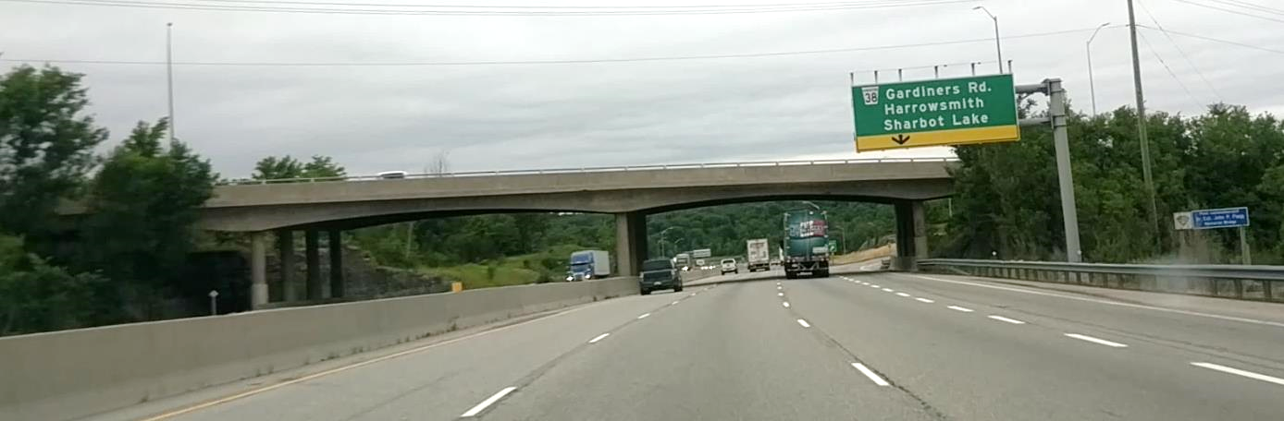
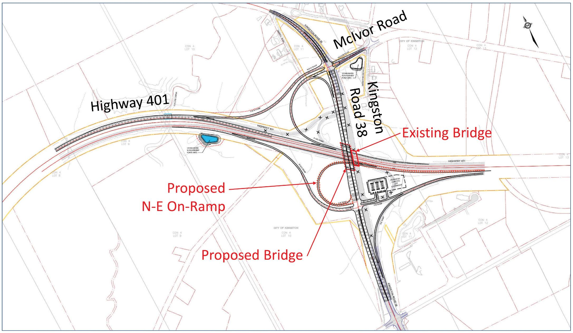
Kingston Road 38 (KR 38) Underpass and Interchange Overview
Background
Existing bridge built in 1961.
Interim interchange improvements were completed in 2021 (Contract 2018-4011).
Previous Approved PD & EA Study (GWP 4049-11-00) identified ultimate improvement recommendations including bridge replacement (3 Southbound (SB) and 3 Northbound (NB) lanes), a new N-E "loop" on-ramp (in the southwest quadrant), and associated tie-in works.
Current Scope of Work
Review previous approved study (GWP 4049-11-00) and develop a preliminary plan for traffic management needs for the construction contract.
Issues & Constraints
Highway 401 detours, lane closures, and traffic disruptions.
Interchange is important for Long Combination Vehicle (LCV) operations and access to the “611 Truck Stop”.
KR 38 Bridge (Westbound)
Proposed KR 38 Bridge and Interchange
9

Slide 10
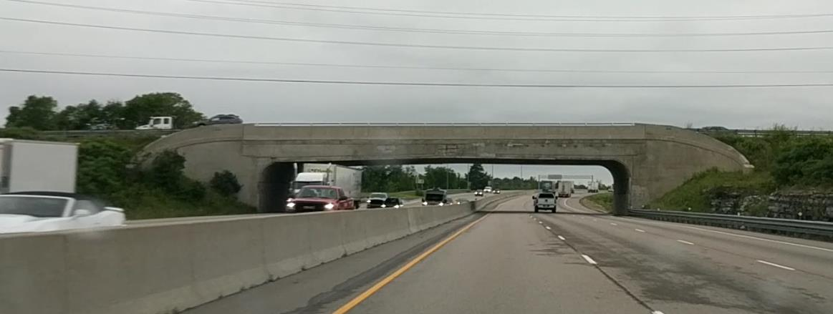
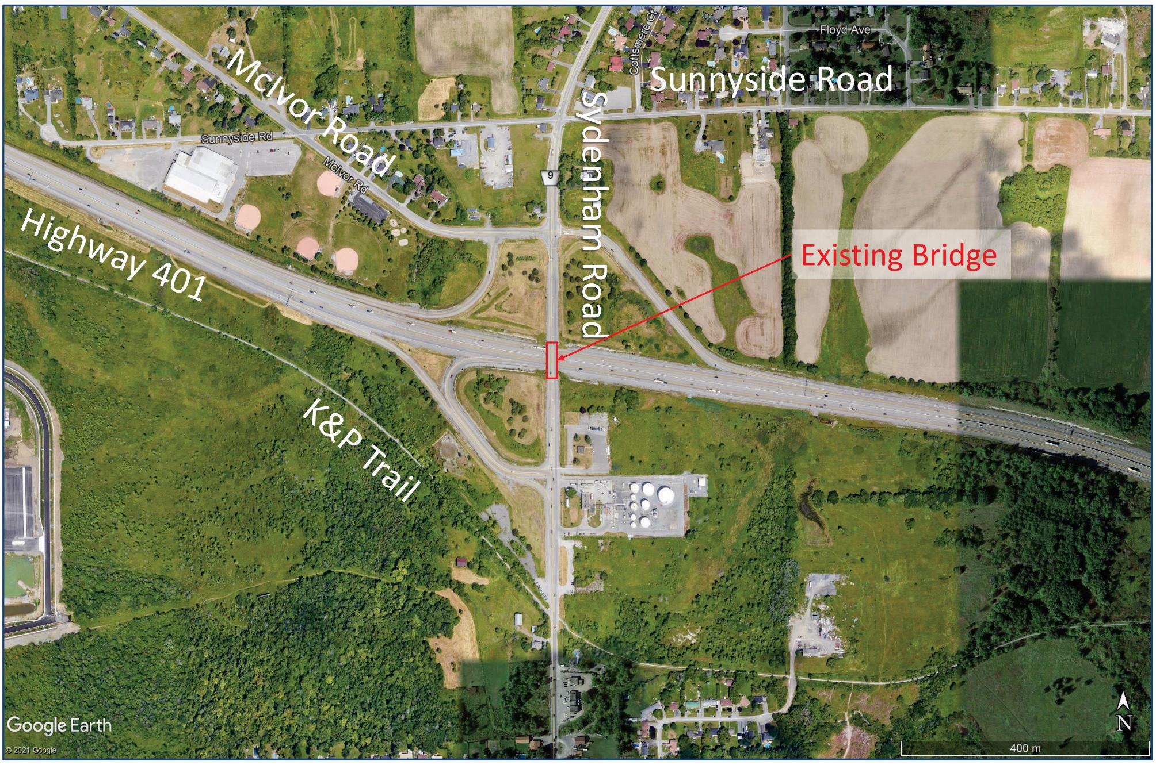
Sydenham Road Underpass & Interchange Overview
Background
Existing bridge built in 1957.
Last major interchange improvements completed in 2009
(WP 28-97-00).
Current Scope of Work
Develop preliminary plan for bridge replacement, interchange improvement (including AT) and traffic management needs for construction.
Issues & Constraints
Highway 401 detours, lane closures, and traffic disruptions.
Utilities (e.g., watermain, TNPI pipeline, Bell, Hydro One, Cogeco).
  Shallow watermain located near Sydenham Road bridge.
Existing industrial/commercial properties, entrances, and proposed developments in the vicinity of the interchange.
Cloverdale Park, K&P Trail and parking lot, watercourses.
Proximity to McIvor Road and Sunnyside Road.
Several potential heritage structures on the north side of the interchange.
Agricultural lands in the northeast quadrant.
Sydenham Road Bridge (Westbound)
10
Sydenham Road Bridge and Interchange

Slide 11
Traffic Assessment Overview
KR 38 Interchange
The previous approved PD & EA Study (GWP 4049-11-00) recommended an interim and ultimate interchange configuration.
The interim works were constructed in 2021 (Contract 2018-4011).
The ultimate plan, which is the subject of this study, includes KR 38 bridge replacement (with three NB and three SB lanes) and the new N-E On-Ramp. These improvements are anticipated to result in acceptable operations in the future horizon year (2055).
Sydenham Road Interchange
To maintain acceptable operations in the future horizon year (2055), widening from two lanes to four lanes (two NB and two SB lanes) is recommended within the interchange area.
Maintaining access to McIvor Road with a signalized intersection is anticipated to deteriorate future interchange traffic operations and result in congested ramp terminal operations in the future horizon year (2055).
Roundabout intersections can provide the highest performing traffic operations (operating well / acceptably in 2055) while maintaining access to McIvor Road.
11

Slide 12
Challenges and Opportunities
Below is a summary of the identified Challenges and Opportunities identified within the Study Area.
Challenges
Two bridges (EB Collins Creek and Sydenham Road) within the study area are nearing the end of their service life and will require replacement in the near future.
Based on the future traffic projections, by 2030, the existing Sydenham Road interchange intersection operations are anticipated to deteriorate with multiple critical traffic movements, and by 2040, it is anticipated that the interchange intersection will not be able to accommodate the projected growth.
Opportunities
Completing the necessary bridge replacements that will protect the safety of the public and provides an opportunity to accommodate the future footprint of Highway 401.
By identifying a future Sydenham Road interchange configuration, the bridge replacement can be implemented efficiently and in a cost-effective manner, minimizing future waste while improving traffic operations.
Identifying the future interchange configuration at Sydenham Road will provide a plan to manage adjacent developments and highway corridor access.
12

Slide 13
Evaluation Process and Selection of the Recommended Plan
  The evaluation process that leads to selection of the Recommended Plan involves a number of steps as outlined below:
The Class EA process requires that alternatives to the proposed undertaking be considered to ensure that there is reasonable and sufficient justification to proceed with the project.
The first step is to develop Alternatives to the Undertaking which are broad level options that represent functionally different ways to address the identified transportation needs. The “Do Nothing” alternative is typically included for consideration as it provides a base to which other alternatives can be compared.
These alternatives are assessed based on their ability to address the identified Challenges and Opportunities and meet the study objectives.
Alternatives to the Undertaking
Following an evaluation of the Alternatives to the Undertaking and selection of the best alternative to carry forward the next step is to identify alternative methods of implementing the undertaking and developing a Long List of Alternatives.
The Long List of Alternatives are then screened in terms of technical feasibility and high-level environmental factors to establish the advantages and disadvantages of each alternative and to identify a Short List of Alternatives to be carried forward for further evaluation using more detailed criteria considered relevant to this undertaking.
Identify and Evaluate
Long List of Alternatives
Identify and Evaluate
Short List of Alternatives
The criteria to be used to evaluate the Short List of Alternatives consider potential effects on the technical, natural, socio-economic, and cultural environments.
The preliminary criteria are presented for public review and comment at PIC#1. The evaluation criteria are then refined based on comments received and used to evaluate the Short List of Alternatives and ultimately, in selection of the Recommended Plan.
The evaluation of the Short List of Alternatives and selection of the Preliminary Recommended Plan will be presented for public review and comment at PIC #2 to be scheduled at a later date.
Following PIC#2 and the receipt of input the Final Recommended Plan will be selected.
The Recommended Plan and associated mitigation will be documented in a TESR which will be made available for a 30-day review period.
Identify Recommended Plan
13

Slide 14
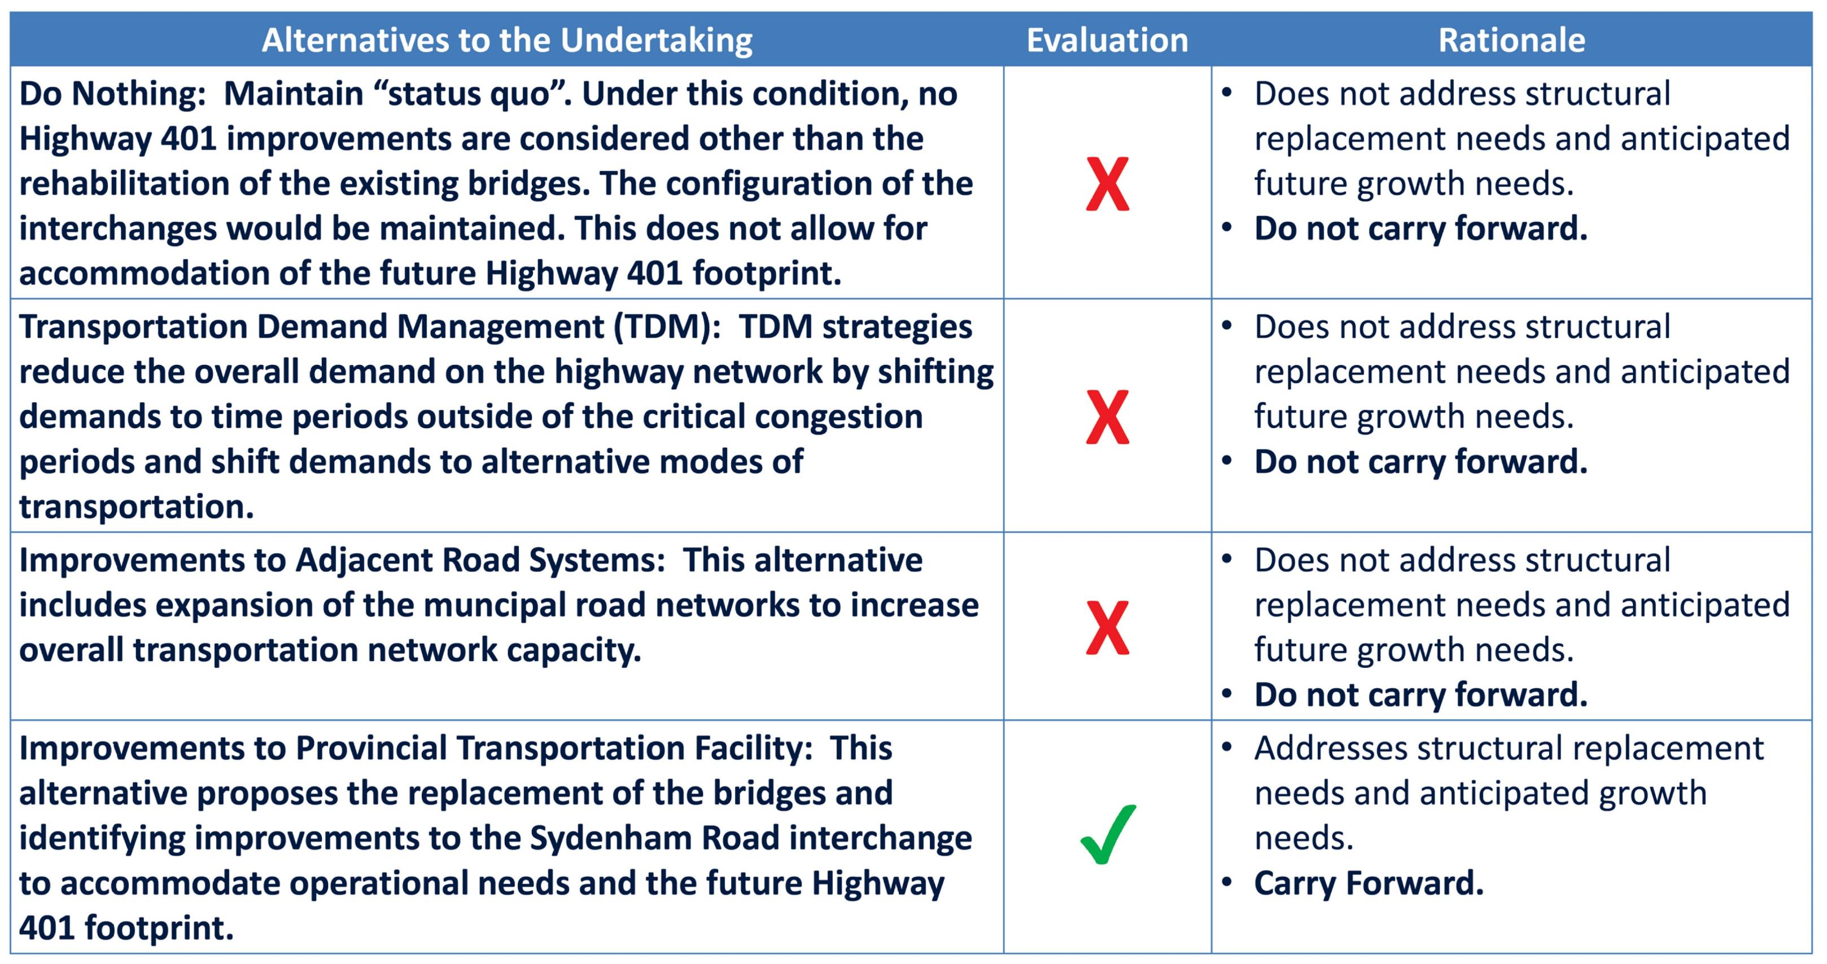
Alternatives to the Undertaking
  The Alternatives to the Undertaking developed for the current project and the associated evaluation are summarized below:
  The Alternatives to the Undertaking were evaluated based on their ability to address the identified challenges / opportunities within the area of study.
  As illustrated, the Improvements to Provincial Transportation Facility alternative is the only option that will fully address the identified transportation challenges/ opportunities.
14

Slide 15
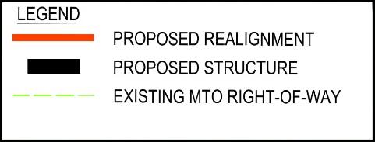
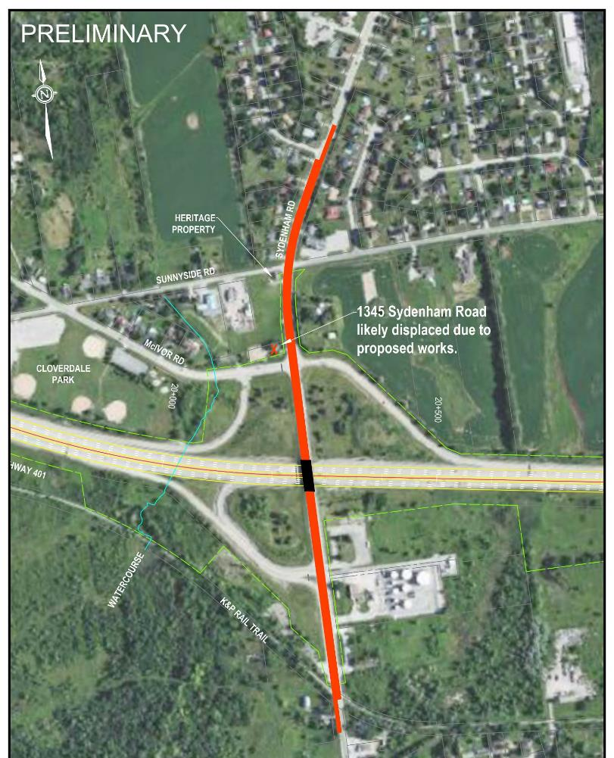
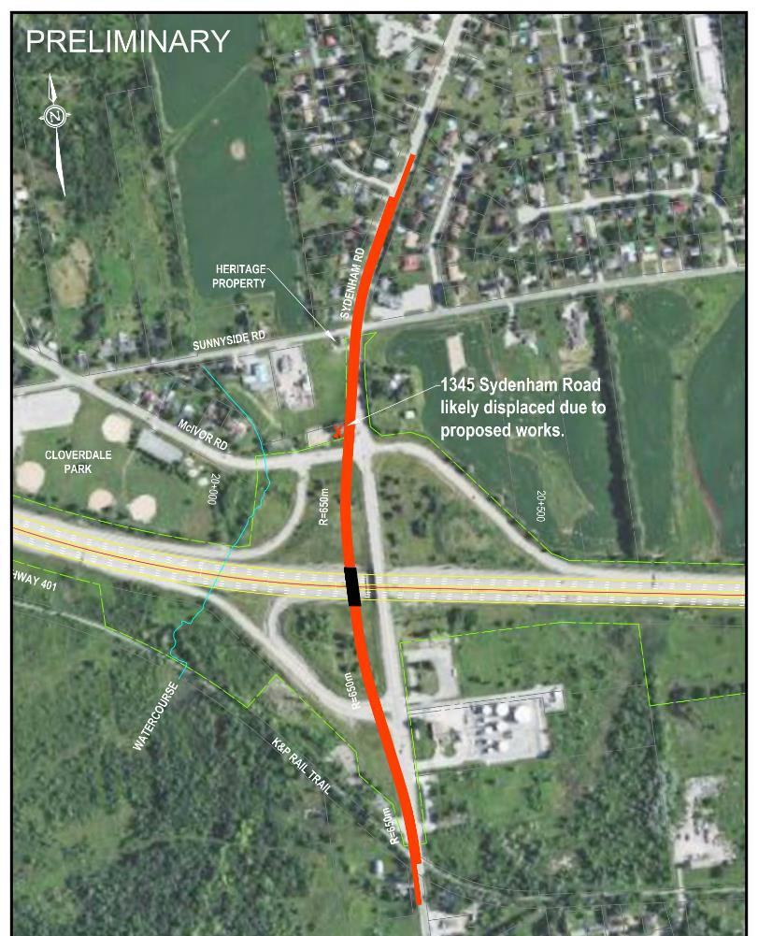

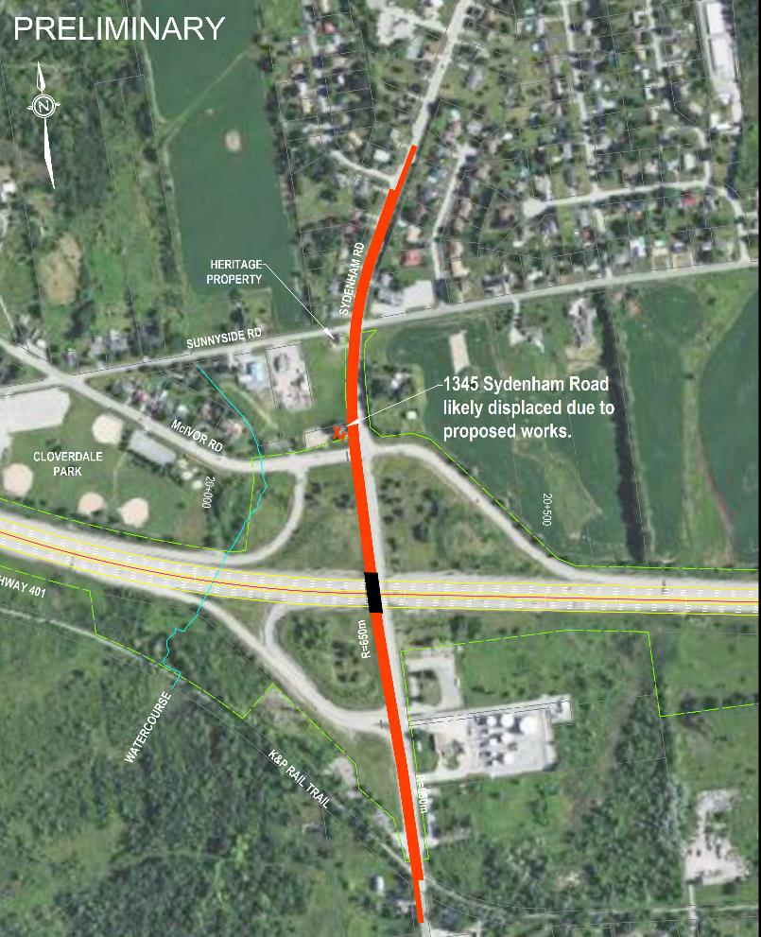

Summary of Long List Alternatives
Sydenham Road Bridge Replacement/Alignment
Sydenham Road will be wider and at a higher elevation through the interchange area because:
  4 through-lanes are required on Sydenham Road at the interchange.
  New bridge needs to allow for a future wider Highway 401 within its 75-year service life.
This will impact entrances and properties in the vicinity of the interchange. Proposed alignment alternatives have been investigated to consider and mitigate these impacts.
Alternative 1:
Bridge Replacement on the Existing Alignment
NOT CARRIED FORWARD
Significant construction traffic impacts (long term road closure).
Significant industrial / commercial property impact and displacements.
Alternative 2:
Bridge Replacement on New Alignment - West Side (No Overlap)
CARRY FORWARD
Avoids long term road closure during new bridge construction.
Avoids industrial / commercial property impact.
Provides an opportunity to maintain or provide a more desirable (safer) access to commercial/industrial properties.
Alternative 3:
Bridge Replacement on New Alignment - East Side (No Overlap)
NOT CARRIED FORWARD
Significant industrial / commercial property impact and displacements.
Alternative 4:
Bridge Replacement on New Alignment - West Side (Overlap)
NOT CARRIED FORWARD
Impacts industrial / commercial properties.
Long construction duration, long term lane closures, and high construction cost.
Alternative 5:
Bridge Replacement on New Alignment - East Side (Overlap)
NOT CARRIED FORWARD
Significant industrial / commercial property impact and displacements.
Long construction duration, long term lane closures, and high construction cost.
Click Here to view a high-resolution version of the Sydenham Road Bridge Replacement / Alignment Alternatives.
15

Slide 16
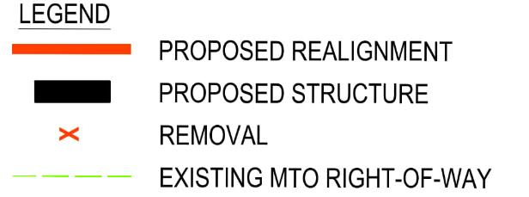
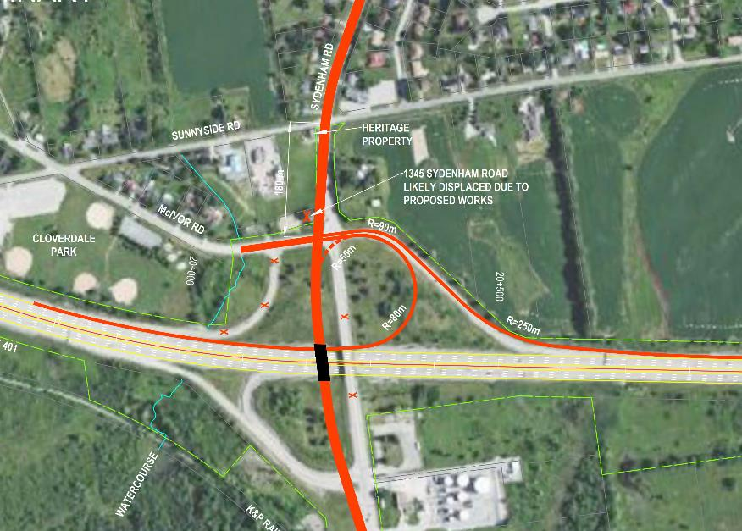
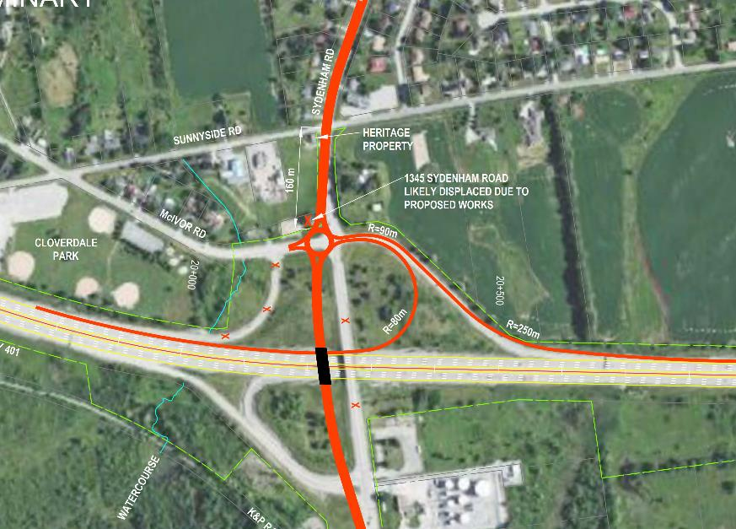
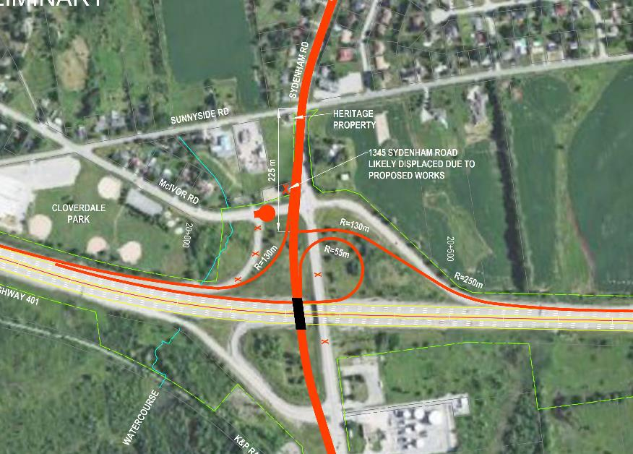
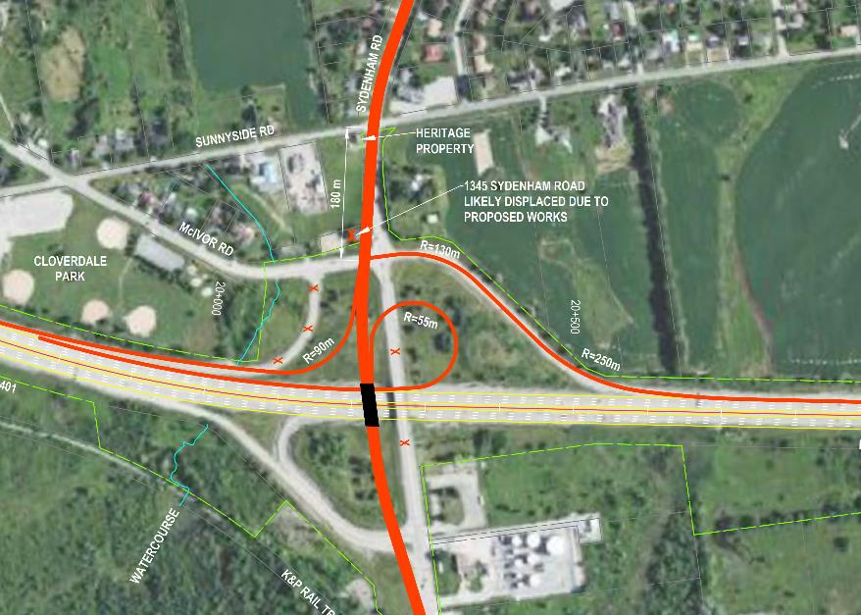
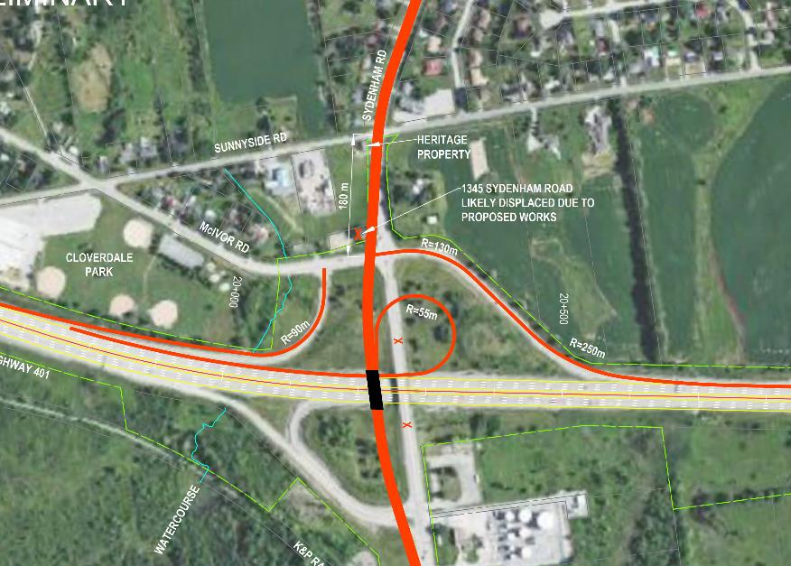
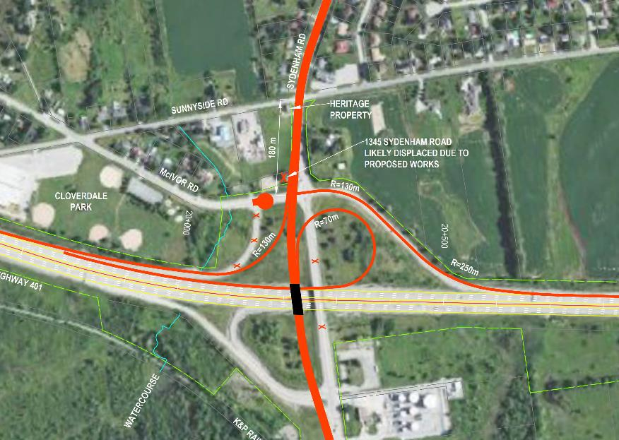
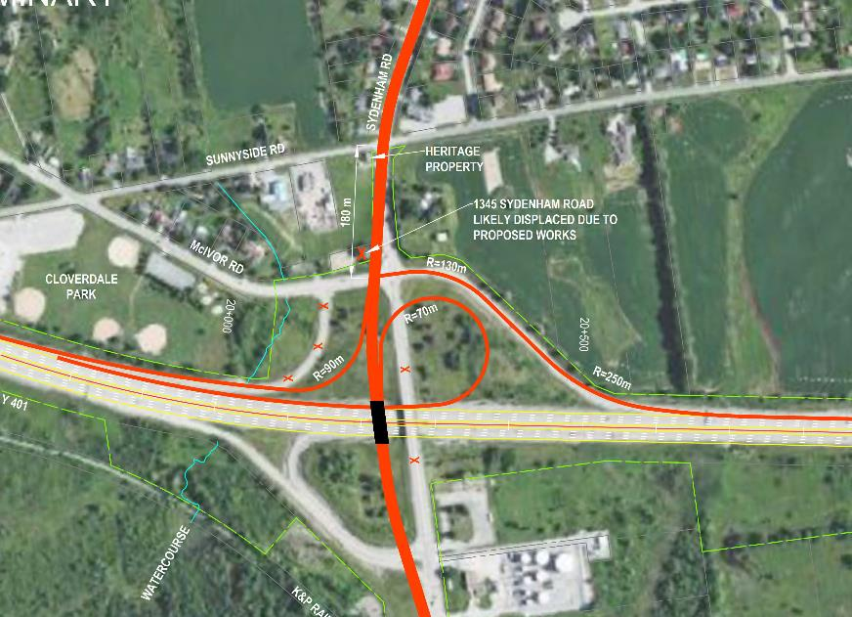
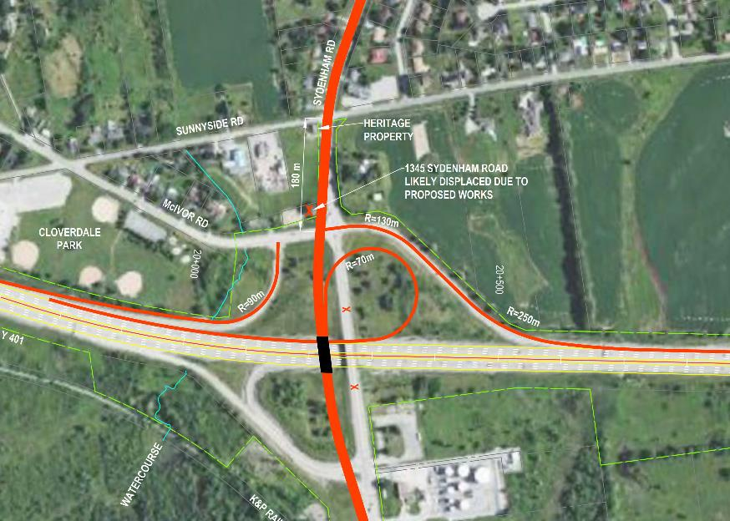
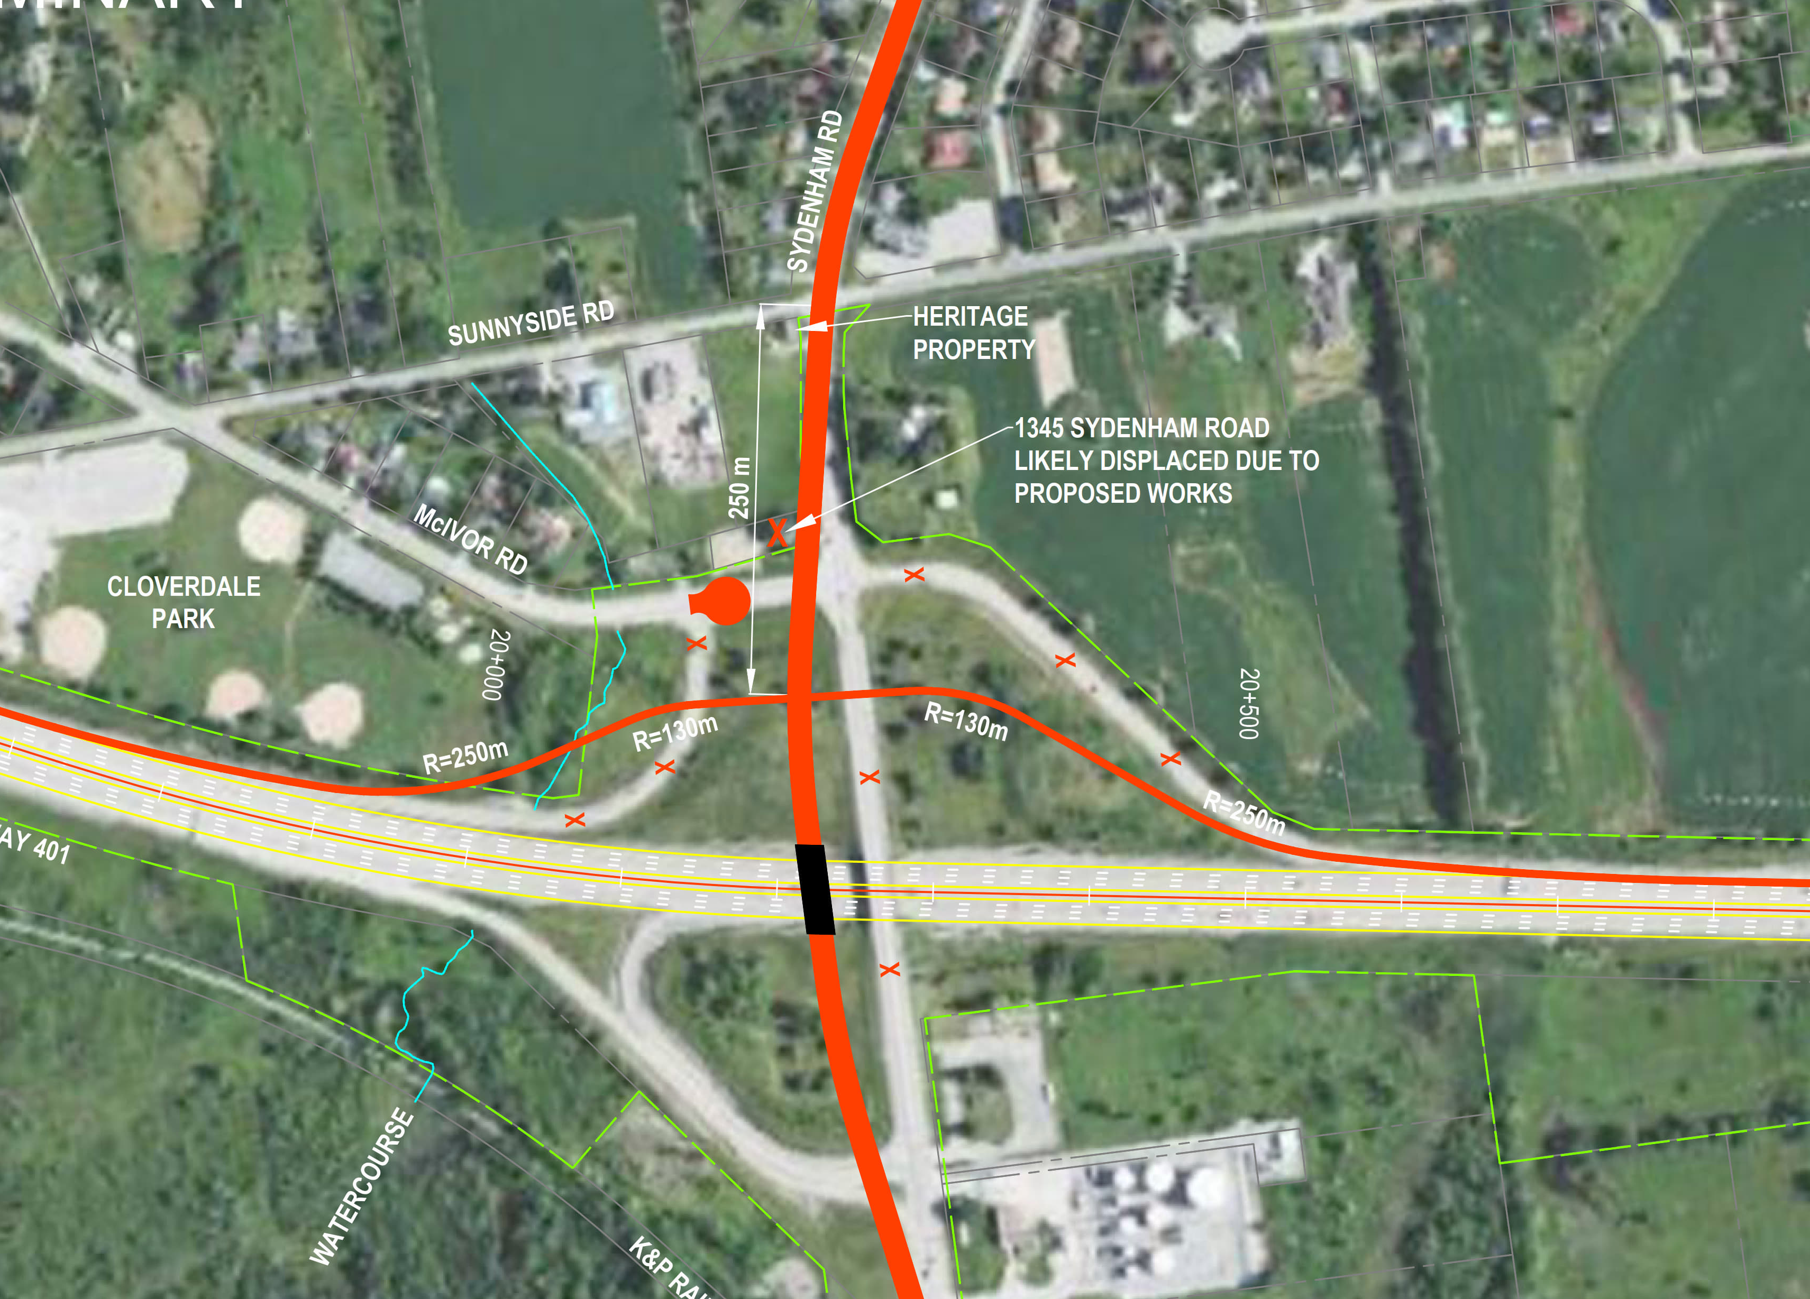

Summary of Long List Alternatives
Sydenham Road Interchange Improvements – North Side
PRELIMINARY
PRELIMINARY
PRELIMINARY
PRELIMINARY
PRELIMINARY
Alternative N1:
Parclo A2 (R = 80 m)
NOT CARRIED FORWARD
Congested operations (2055).
Alternative N2:
Parclo A2 (R = 80 m) with Roundabout
CARRY FORWARD
Operates well (2055).
Operates better than all alternatives.
Maintains access to McIvor Road
Alternative N3A:
Parclo A4 (R = 55 m)
CARRY FORWARD
Acceptable operations (2055).
Operates better than all other signalized alternatives (However, closes McIvor Road, and permanently detours traffic to Sunnyside Road.)
Alternative N3B:
Parclo A4 (R = 55 m)
CARRY FORWARD
Maintains McIvor Road
(However, congested operations (2055)).
Alternative N3C:
Modified Parclo A4 (R = 55 m)
NOT CARRIED FORWARD
Congested operations (2055).
Maintains undesirable buttonhook configuration.
PRELIMINARY
PRELIMINARY
PRELIMINARY
PRELIMINARY
PRELIMINARY
Alternative N4A:
Parclo A4 (R = 70 m)
NOT CARRIED FORWARD
Similar to N3A, but only slightly enhanced geometry with incrementally greater impacts.
Alternative N4B:
Parclo A4 (R = 70 m)
NOT CARRIED FORWARD
Similar to N3B, but only slightly enhanced geometry with incrementally greater impacts.
Alternative N4C:
Modified Parclo A4 (R = 70 m)
NOT CARRIED FORWARD
Similar to N3C, but only slightly enhanced geometry with incrementally greater impacts.
Alternative N5:
Diamond
NOT CARRIED FORWARD
Closes McIvor Road.
Greater impact to Cloverdale Park, Natural Environment, and Watercourses.
Cannot be upgraded in the future without significant work. (However, acceptable operations (2055)).
Alternative N6:
Modified Diamond
NOT CARRIED FORWARD
Congested operations (2055).
Maintains undesirable buttonhook configuration.
Click Here to view a high-resolution version of the North Side Sydenham Road Interchange Improvements Alternatives.
16

Slide 17
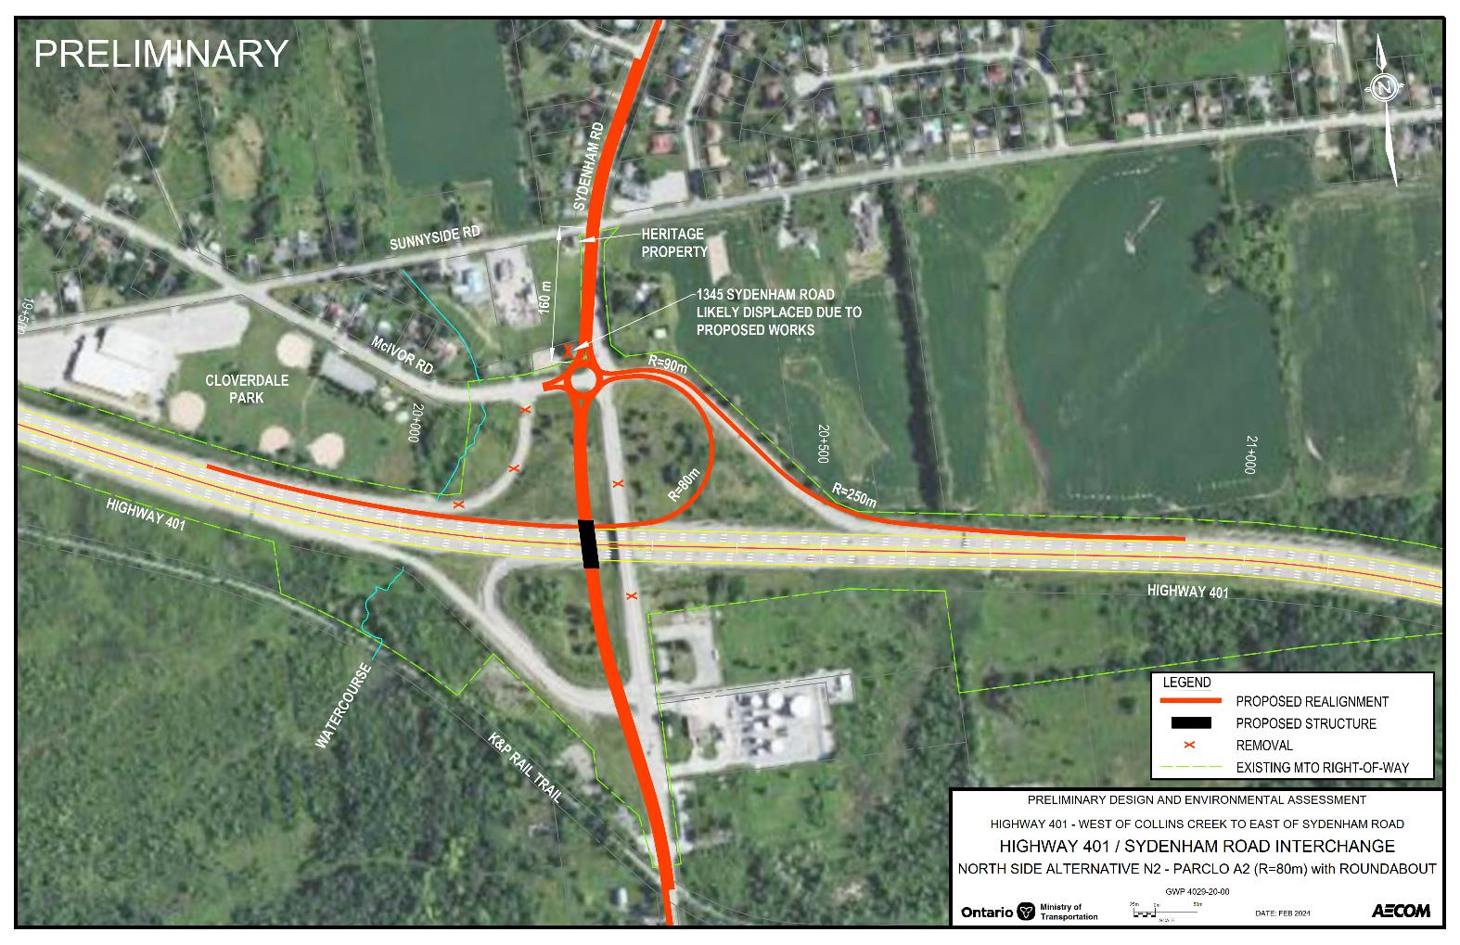

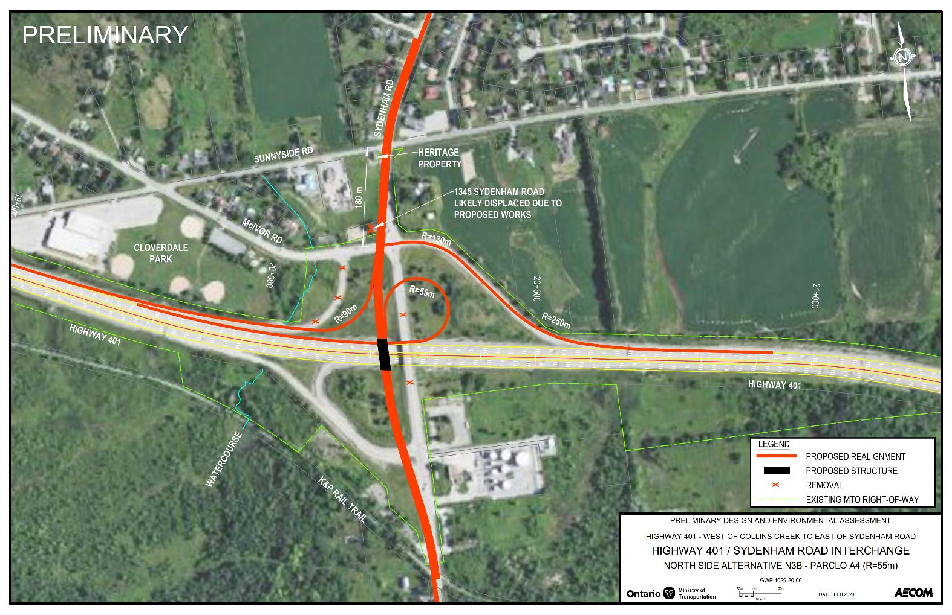
Summary of Long List Alternatives
Sydenham Road Interchange Improvements – North Side (Carried Forward to Short List Evaluation)
Alternative N2
Parclo A2 with Roundabout
Alternative N3A
Parclo A4 with McIvor Closed
Alternative N3B
Parclo A4 with McIvor Open
Click Here to view a high-resolution version of the North Side Sydenham Road Interchange Improvements Alternatives.
17

Slide 18
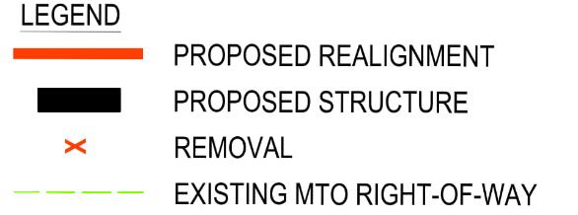
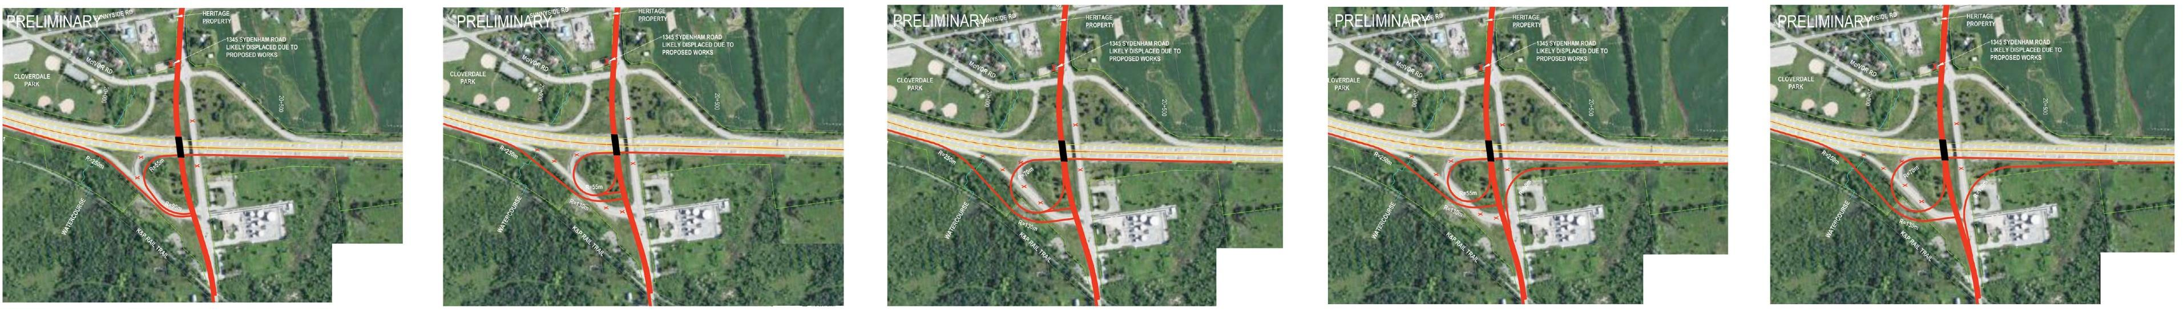
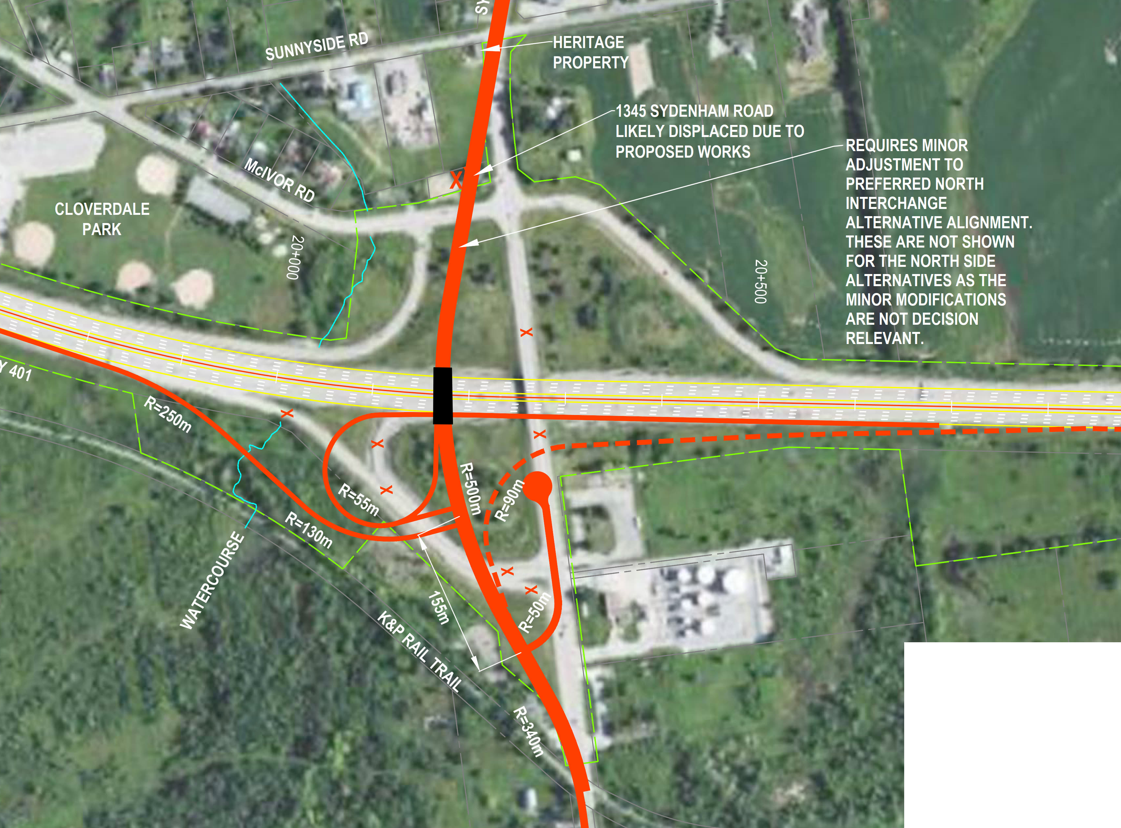
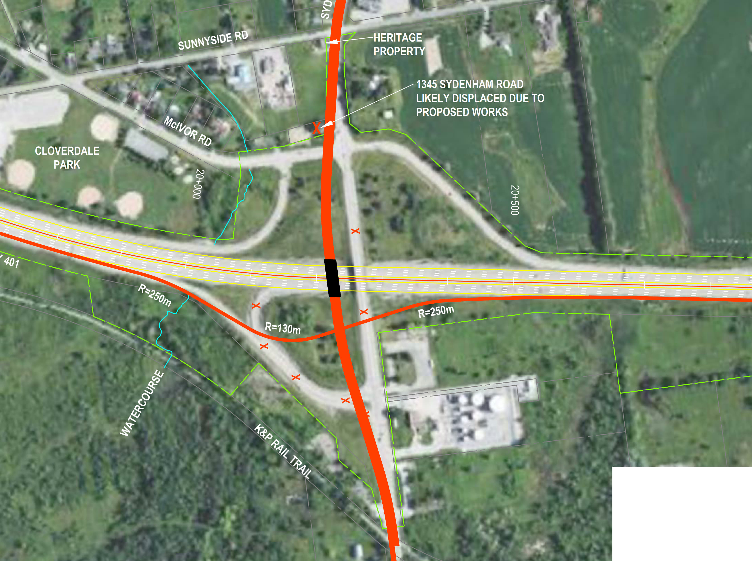

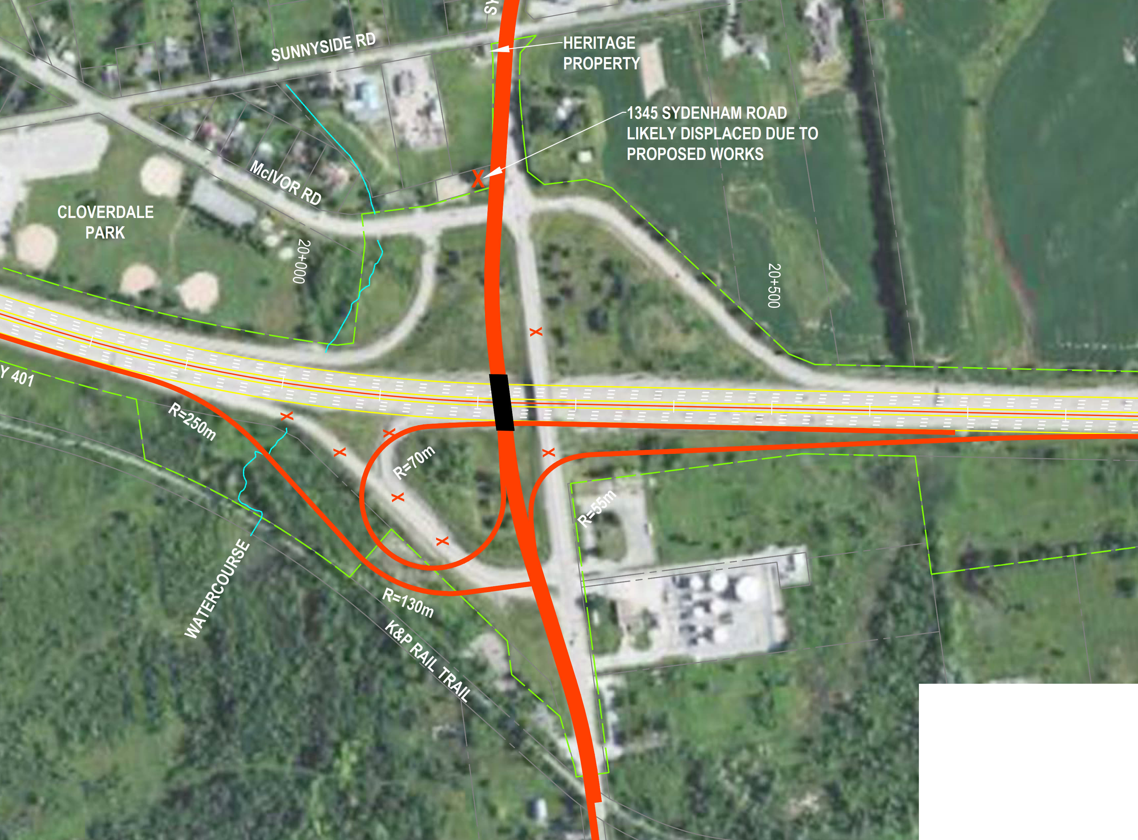
Summary of Long List Alternatives
Sydenham Road Interchange Improvements – South Side
Alternative S1:
Parclo A2 (R = 55 m / 90 m)
NOT CARRIED FORWARD
Congested operations (2055).
Maintains existing undesirable access condition for entrances.
Alternative S2:
Parclo A2 (R = 55 m)
NOT CARRIED FORWARD
Cannot be upgraded to Parclo A4 without displacing the industrial / commercial properties (very high cost).
Provides a less desirable access condition for entrances.
Alternative S3:
Parclo A2 (R = 70 m)
CARRY FORWARD
Acceptable operations (2055). (However, generally maintains undesirable access condition, mitigation required).
Can be upgraded to Parclo A4 when required in the future (Requires west realignment).
Alternative S4:
Parclo A4 (R = 55 m)
NOT CARRIED FORWARD
Displaces industrial / commercial properties (very high cost).
Alternative S5A:
Parclo A4 (R = 70 m)
NOT CARRIED FORWARD
Displaces industrial / commercial properties (very high cost).
PRELIMINARY
PRELIMINARY
PRELIMINARY
PRELIMINARY
Click Here to view a high-resolution version of the South Side Sydenham Road Interchange Improvements Alternatives.
Alternative S5B:
Parclo A4 (R = 70 m)
NOT CARRIED FORWARD
Similar to S3. (However, S3 also provides acceptable traffic operations and lower construction costs.)
Alternative S6:
Diamond
NOT CARRIED FORWARD
Cannot be upgraded in the future without significant work. (However, acceptable operations (2055)).
Provides a less desirable access condition for entrances.
Alternative S7*:
Parclo A2 (R = 55 m) with Roundabout CARRY FORWARD
Operates well (2055).
Provides a more desirable (safer) access condition by consolidating entrances on an access road linked to roundabout.
Alternative S8*:
Parclo A2 (R = 55 m)
CARRY FORWARD
Acceptable operations (2055).
Provides a more desirable (safer) access condition by consolidating entrances on an access road.
Does not preclude a future S-E Ramp (dashed line) to increase interchange capacity (beyond the horizon year).
*Requires minor adjustment to preferred north interchange alternative alignment. These are not shown on slides 16 & 17 as the minor modifications are not decision relevant.
18

Slide 19
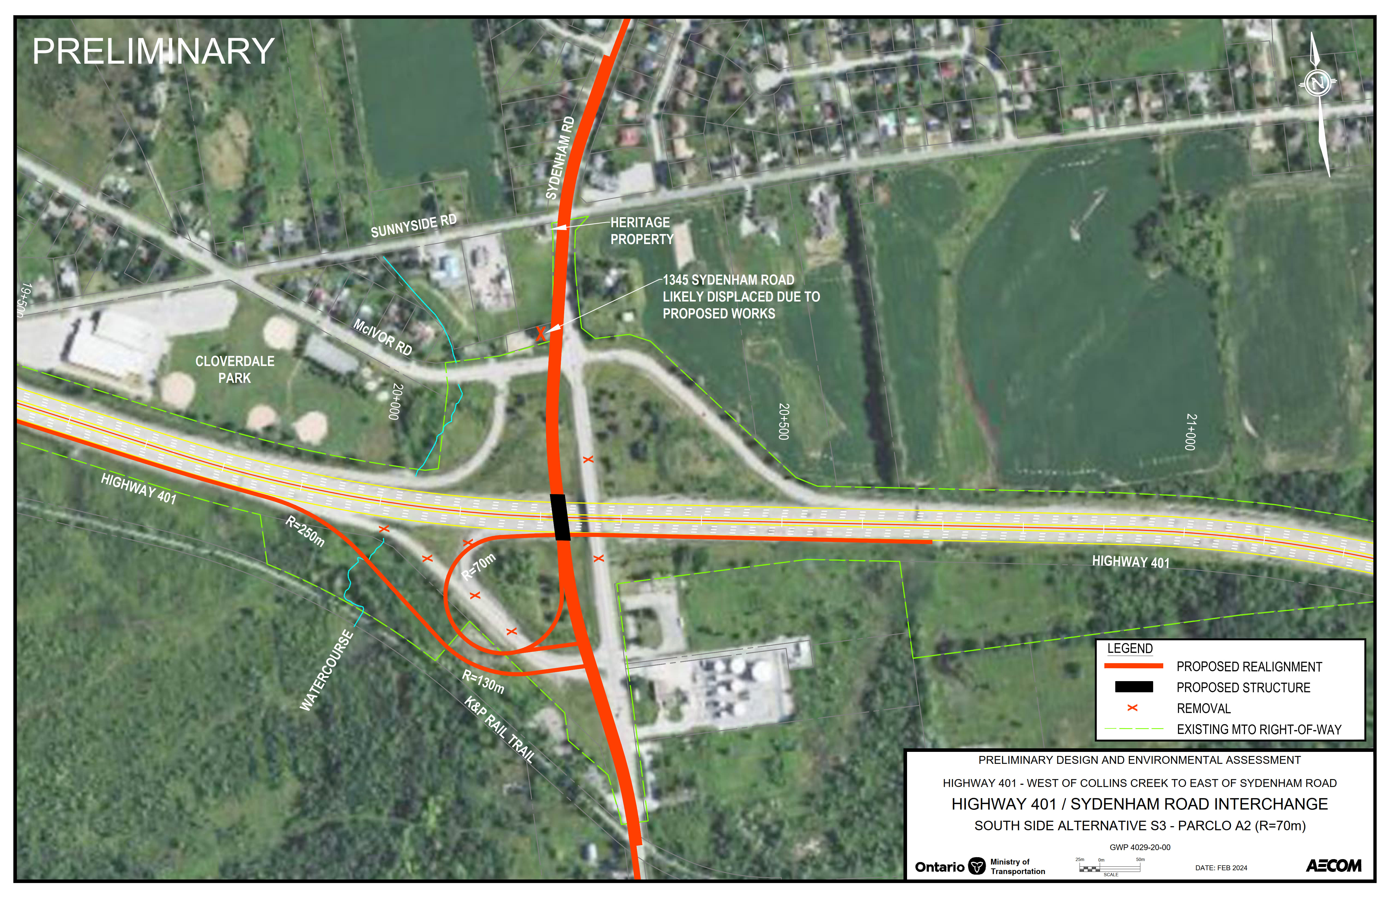
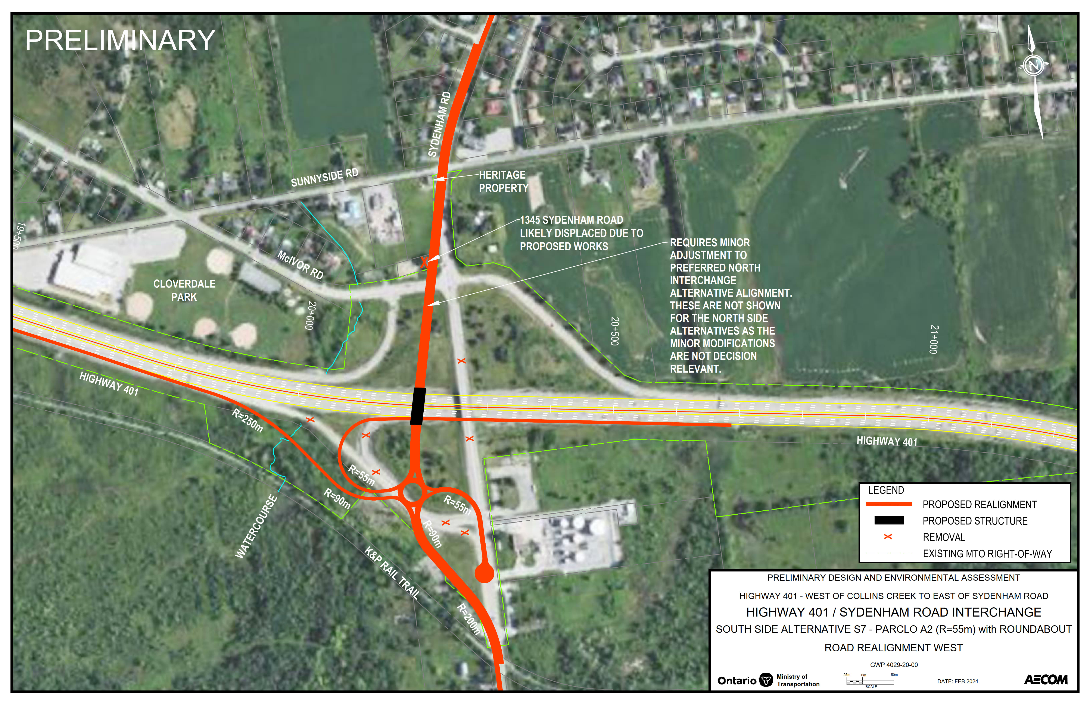
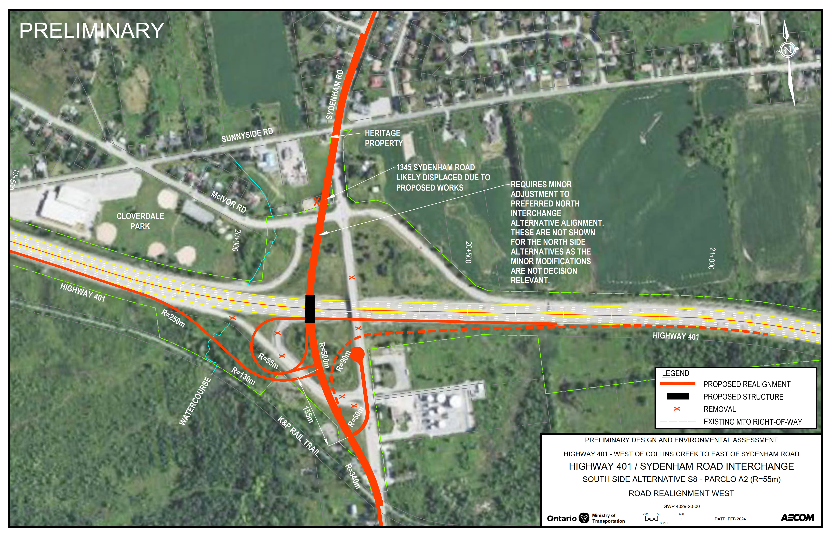
Summary of Long List Alternatives
Sydenham Road Interchange Improvements – South Side (Carried Forward to Short List Evaluation)
REQUIRES MINOR ADJUSTMENT TO PREFERRED NORTH INTERCHANGE ALTERNATIVE ALIGNMENT. THESE ARE NOT SHOWN ON SLIDES 16 & 17 AS THE MINOR MODIFICATIONS ARE NOT DECISION RELEVANT
REQUIRES MINOR ADJUSTMENT TO PREFERRED NORTH INTERCHANGE ALTERNATIVE ALIGNMENT. THESE ARE NOT SHOWN ON SLIDES 16 & 17 AS THE MINOR MODIFICATIONS ARE NOT DECISION RELEVANT
Alternative S3
Parclo A2
Alternative S7*
Parclo A2 with Roundabout
Alternative S8*
Parclo A2
For Alternative S3:
Mitigation is required to address access concerns associated with multiple entrances at the south ramp terminal intersection.
*Requires minor adjustment to preferred north interchange alternative alignment. These are not shown on slides 16 & 17 as the minor modifications are not decision relevant.
Click Here to view a high-resolution version of the South Side Sydenham Road Interchange Improvements Alternatives.
19

Slide 20







Short List Evaluation Criteria
The following preliminary evaluation criteria has been identified by the Project Team to evaluate the Short List of Alternatives and select the Recommended Plan.
  Transportation and Constructability
  Traffic Operations
  Geometrics
  Safety
  Constructability
  Potential to impact existing utility and servicing infrastructure
  Natural Environment
  Fish and Fish Habitat
  Wildlife and Wildlife Habitat
  Species at Risk
  Surface Water / Groundwater
  Designated Natural Areas / Wetlands & Vegetation Communities
  Contamination
  Cost
  Construction Costs
  Property Acquisition Costs
  Operational / maintenance Costs
  Socio-Economic Environment
  Community Impacts
  Existing & Planned Land Uses
  Noise & Air Quality
  Property Impacts
  Impacts to Emergency Services
  Recreational Trails / Active Transportation Networks
  Climate Change
Following PIC #1 an Evaluation Matrix will be developed to assess each of the alternatives in terms of the potential to impact each of the above noted criteria.
This will assist in making selection of a Recommended Plan that will address the issues and deficiencies, but also keep impacts to a minimum.
  Cultural Environment
  Archaeological resources
  Built Heritage and Cultural Heritage Landscapes
  Let us know what other criteria should be included!
20

Slide 21
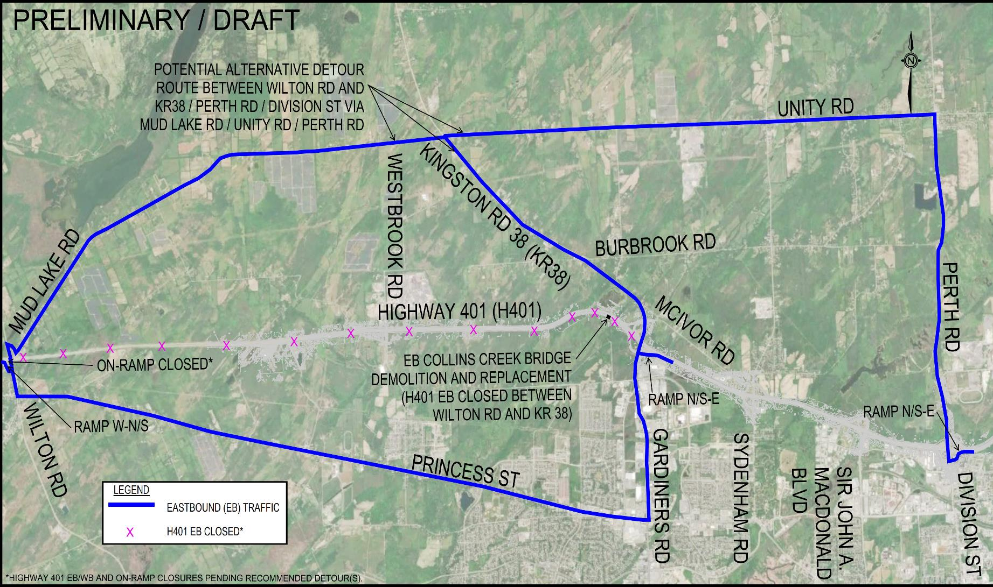
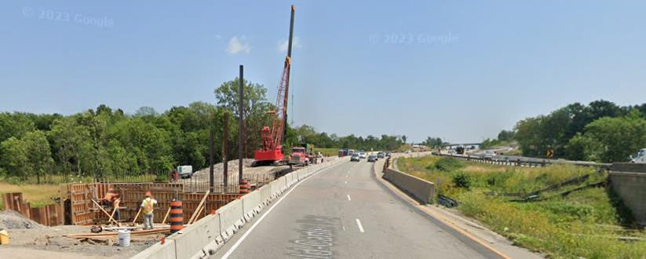
Preliminary Traffic Management – EB Collins Creek Bridge
Single stage structure replacement is not preferred.
  Several months with major EB traffic detour off Highway 401 onto municipal roads (see Figure 1).
Single stage replacement with temporary works (i.e., median highway crossovers) is not preferred.
  Closure of the KR 38 W-N/S Off-Ramp (impacts LCV routes), and significant temporary works and throwaway costs.
Staging the bridge replacement and demolition on Highway 401 is preferred (see Figure 2).
Part of the new bridge is constructed in the highway median with traffic on the original bridge. Once the first part of the new bridge is constructed, traffic is shifted, demolition of the old bridge is completed, and the remaining part of the new bridge is constructed.
Minimizes traffic detours, lane closures, traffic disruptions, and impacts to the municipal network.
Staging may be coordinated with KR 38 bridge replacement for efficiency.
Figure 1: EB detour alternatives for a single stage structure replacement including Highway 401 EB full closure at EB Collins Creek (Not Preferred).
Click Here to view a high-resolution version of the Preliminary Traffic Management Alternatives.
Figure 2: Example staged bridge replacement. East view of the recent staged replacement at WB Collins Creek (Contract 2018-4011) (Preferred).
21

Slide 22
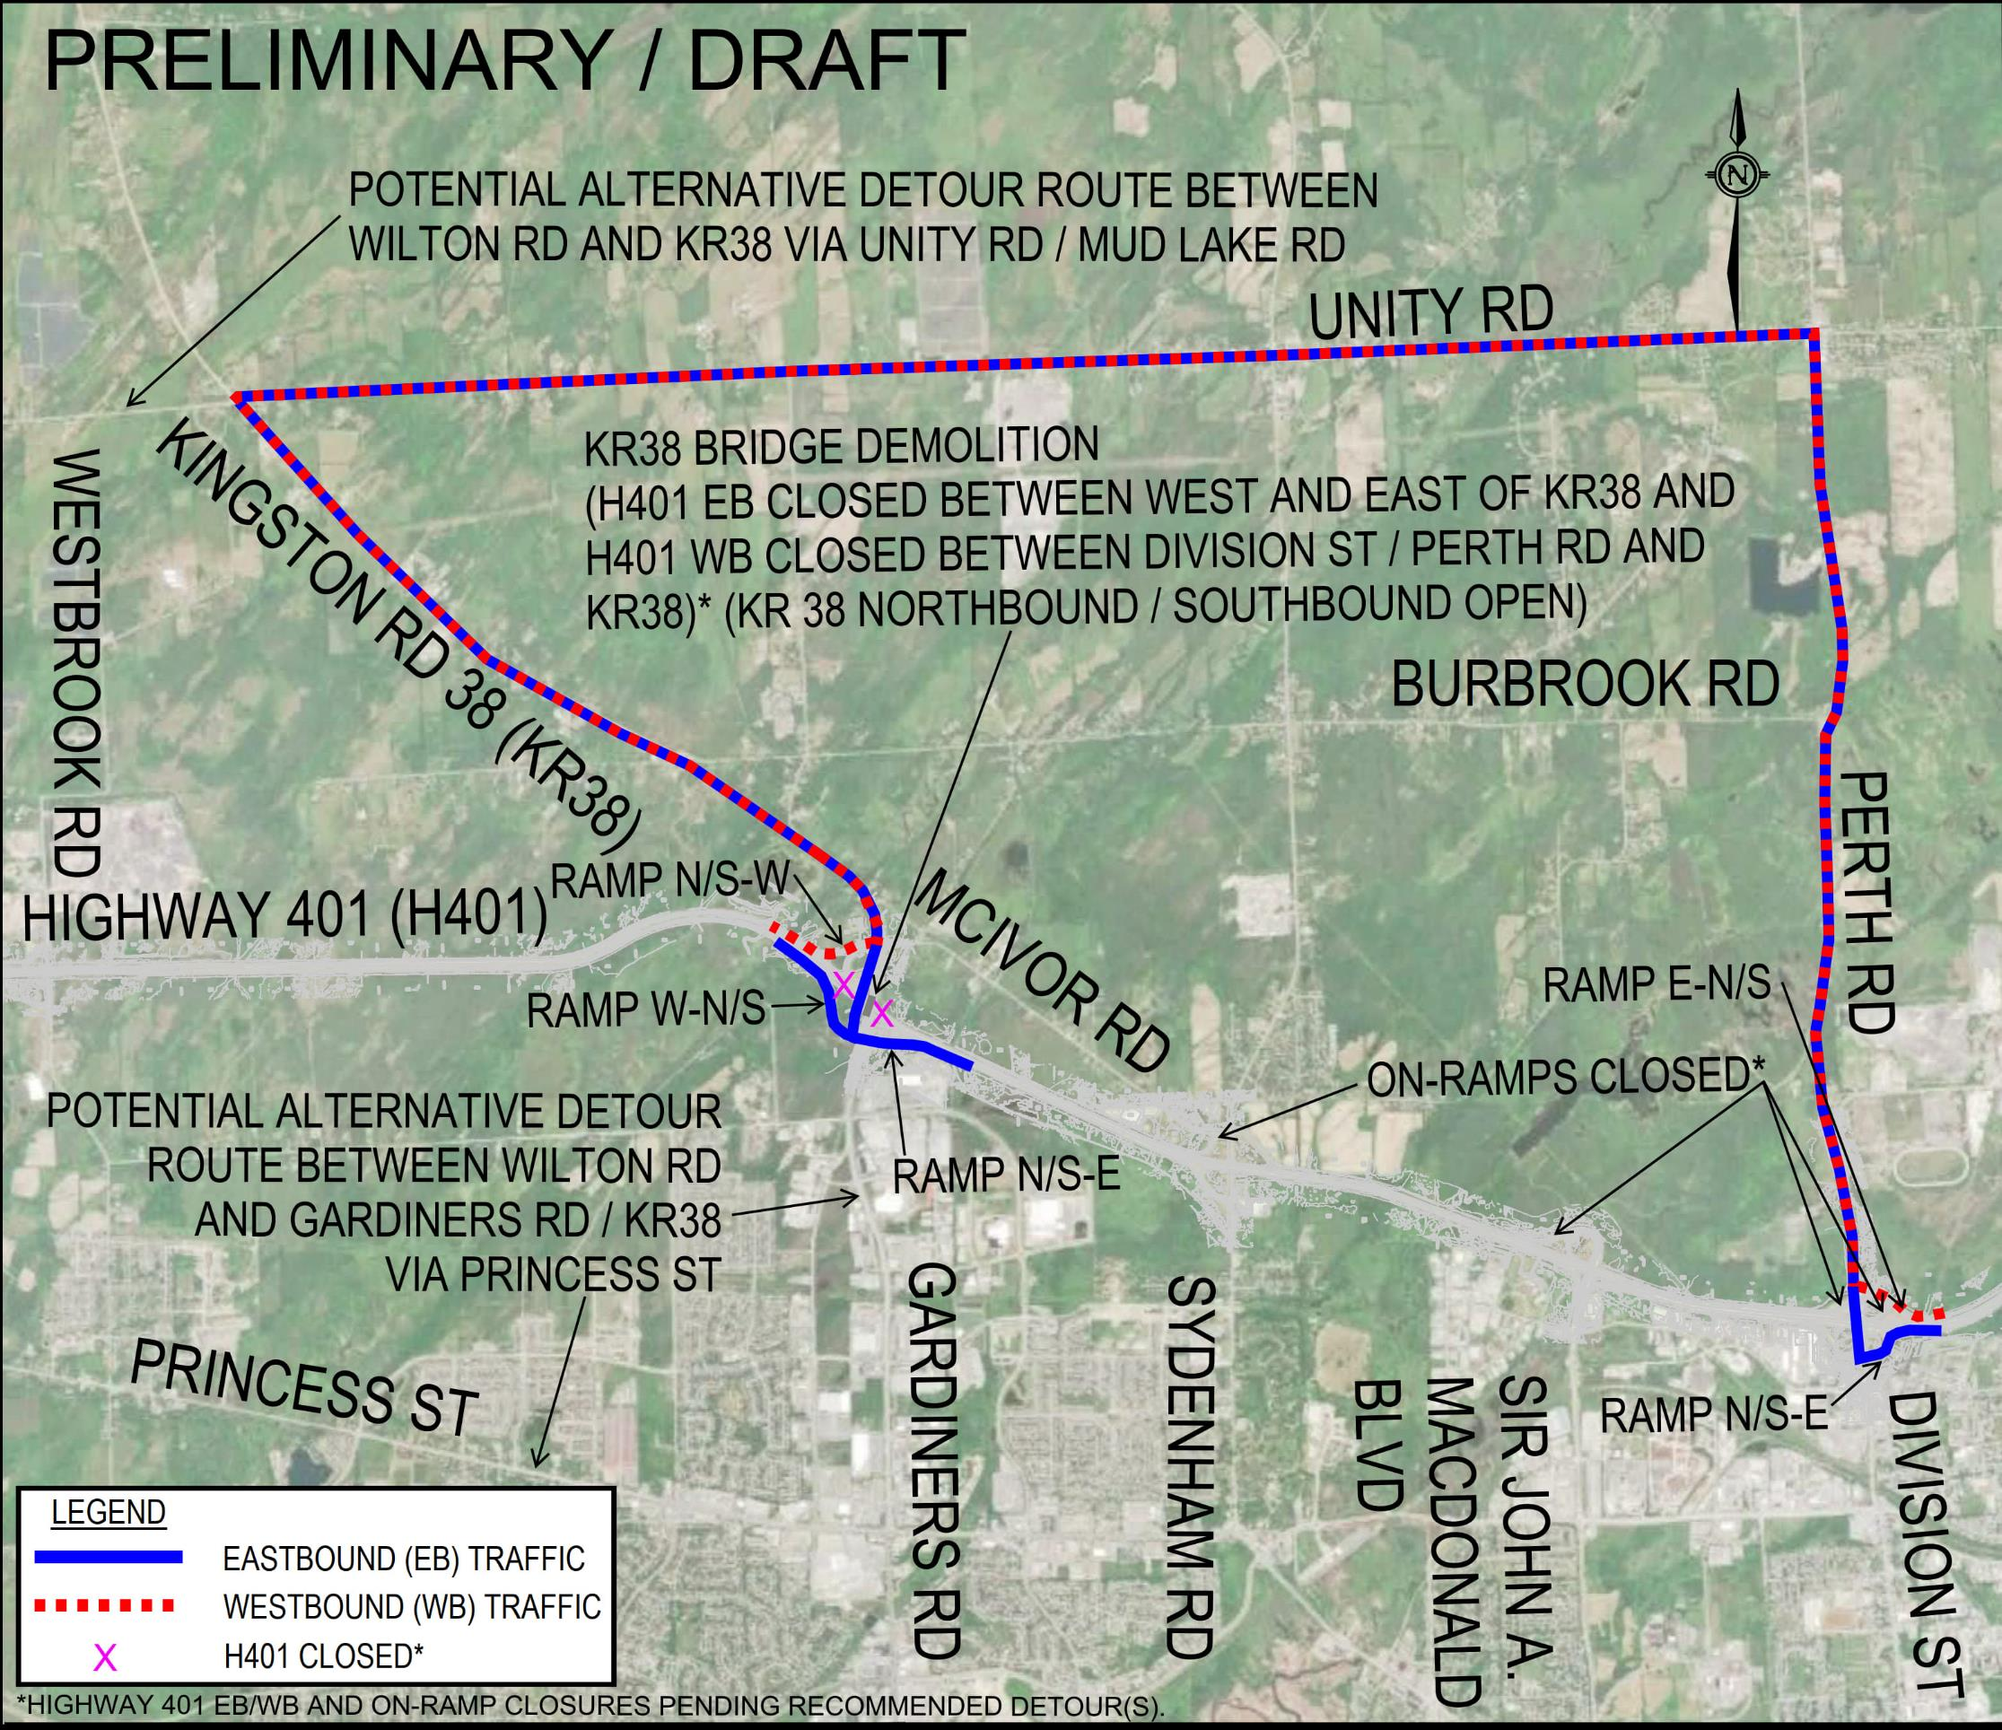
Preliminary Traffic Management – KR 38 Bridge and Interchange
Proposed replacement structure on separate alignment west of the existing bridge per previous Approved PD & EA Study (GWP 4049-11-00)
  Minimizes KR 38 road closures.
Demolition of the bridge in multiple stages over multiple weeks is not preferred
  Extended traffic disruption and impacts due to Highway 401 lane reductions, and significant temporary works and throwaway costs.
Bridge demolition in a single stage is preferred.
  This typically requires a one-night planned full closure with traffic detours (see Figure 1).
  The closure can be scheduled outside of the tourist season and peak traffic flows, with planned detours.
  Bridge replacement girder erection may also require limited planned highway lane closures (e.g., rolling closures) and detours.
Figure 1: EB/WB detour alternatives for a one-night highway closure at KR 38 (Preferred). *Highway 401 EB/WB and On-Ramp closures pending recommended detour(s).
Click Here to view a high-resolution version of the Preliminary Traffic Management Alternatives.
22

Slide 23
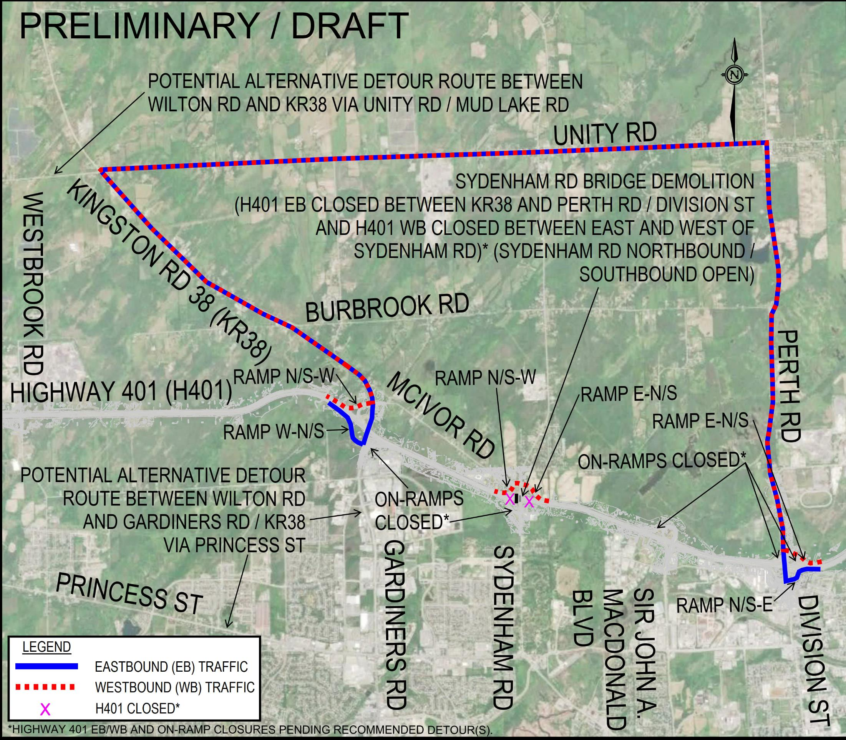
Preliminary Traffic Management – Sydenham Road Bridge and Interchange
Proposed replacement structure on separate alignment west of the existing bridge.
  Minimizes Sydenham Road closures.
Demolition of the bridge in multiple stages is not technically feasible.
Bridge demolition in a single stage is preferred.
  This typically requires a one-night planned full closure with traffic detours (see Figure 1).
  Minimizes Sydenham Road closures.
  This can be scheduled outside of the tourist season and peak traffic flows, with planned detours.
  The associated bridge replacement girder erection may also require limited planned highway lane closures (e.g., rolling closures) and traffic detours.
Figure 1: EB/WB detour alternatives for a one-night highway closure at Sydenham Road (Preferred) . *Highway 401 EB/WB and On-Ramp closures pending recommended detour(s).
Click Here to view a high-resolution version of the Preliminary Traffic Management Alternatives.
23

Slide 24
Next Steps & How to Stay Informed
  Following this PIC the Project Team will:
  Respond to comments received.
  Complete the evaluation of the Short List of Alternatives.
  Present the evaluation of the Short List of Alternatives and the Preliminary Recommended Plan at PIC #2.
  The following information is available on the Study Website for this PIC:
  PIC #1 Video Presentation
  PIC #1 Presentation Slides [PDF]
  PIC #1 Presentation Transcript [PDF]
  Sydenham Road Bridge Replacement / Alignment Alternatives [PDF]
  Sydenham Road Interchange Alternatives [PDF]
  Preliminary Traffic Management Alternatives [PDF]
  Project website at: Hwy401KingstonBridgesEA.ca
24

Slide 25
Thank You!
Thank you for attending PIC #1!
  A PIC Comment Form can be found via the Study Website.
  Please provide any comments by June 7, 2024.
For more information:
  Visit our Study Website at: Hwy401KingstonBridgesEA.ca
  Email the Project Team at: ProjectTeam@Hwy401KingstonBridgesEA.ca
  Contact us by telephone:
Pour obtenir des renseignements en français,
composer le 1-705-919-6786 (Patrick Hébert), Courriel: patrick.hebert1@aecom.com
Nancy Elliott, P.Eng.
Senior Project Engineer
Ministry of Transportation, Project Delivery East
1355 John Counter Boulevard, Postal Bag 4000
Kingston, Ontario K7L 5A3
Geoff Coy, P.Eng.
AECOM Project Manager
105 Commerce Valley Drive West, 7th Floor
Markham, Ontario L3T 7W3
Tel: (905) 418-1502
Freedom of Information and Protection of Privacy Act. Comments and information regarding this study are being collected to assist the MTO and AECOM in meeting the requirements of the Ontario Environmental Assessment Act, and in accordance with the Freedom of Information and Protection of Privacy Act. With the exception of personal information, all comments will become part of the public record.
25

